Slide 1
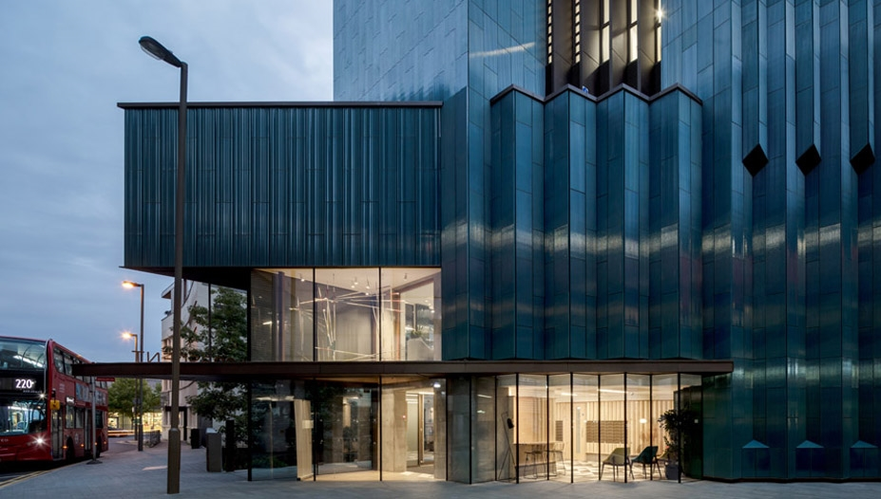
Project | Mapleton Crescent SW18
Client | Pocket Living
Architect | Metropolitan Workshop
Constructor | Donban
Sector | Residential
System | Volumetric Modular

Slide 2
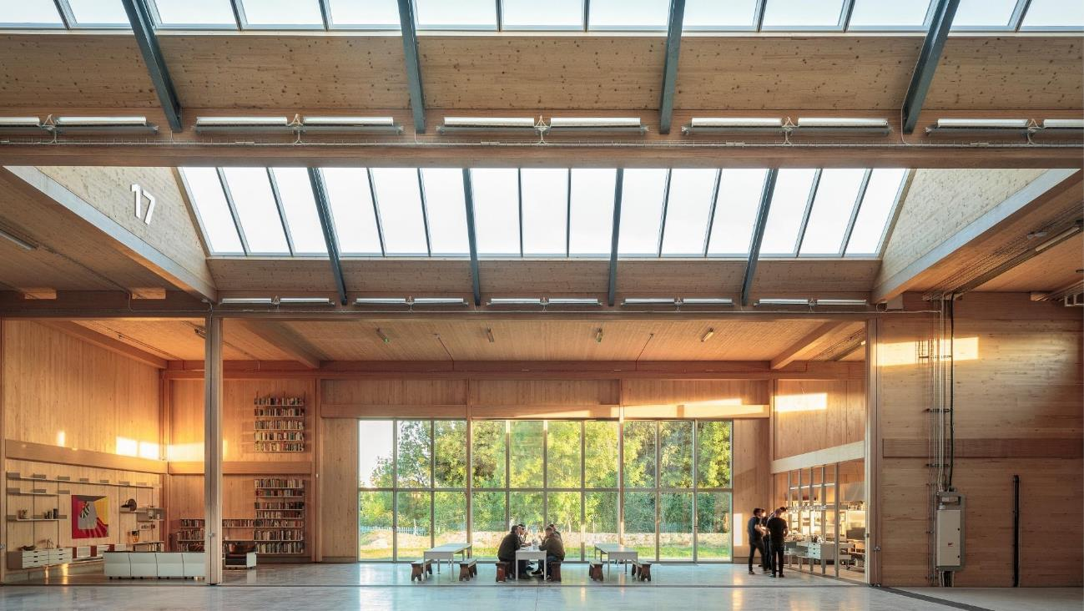
Project | Vitsoe Fsctory, Leamington Spa
Sector | Manufacturing
Designers | Waugh Thistleton Architects
Technology | Mass engineer timber
Construction Management | JCA Concept Construction

Slide 3
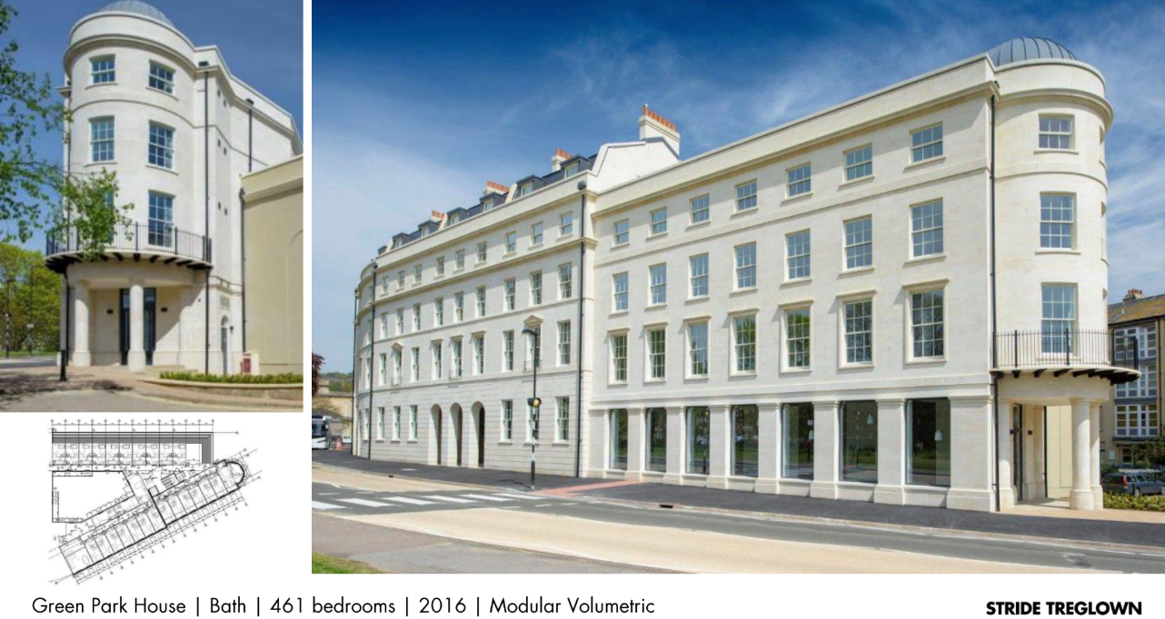

Slide 4
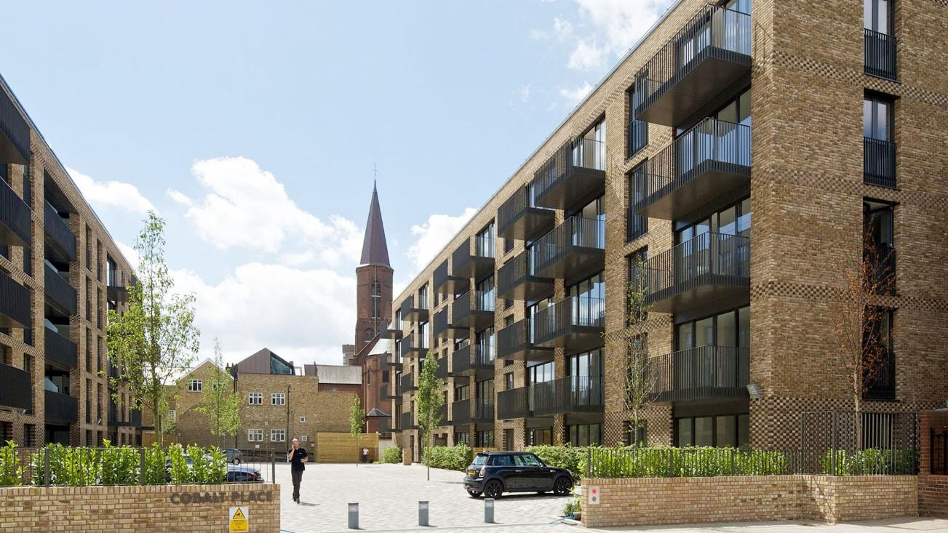
Project | Colbalt Place
Sector | Residential
Developer | Lendlease
Technology | Hybrid CLT, Concrete & Steel

Slide 5
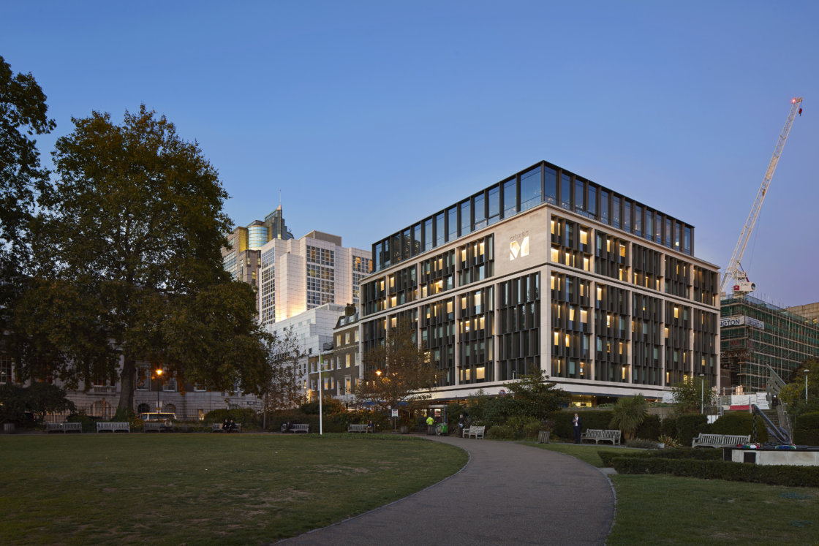
Project | citizen Hotel, Tower of London
Designer | Sheppard Robson
Sector | Leisure
Technology | Volumetric modular

Slide 6
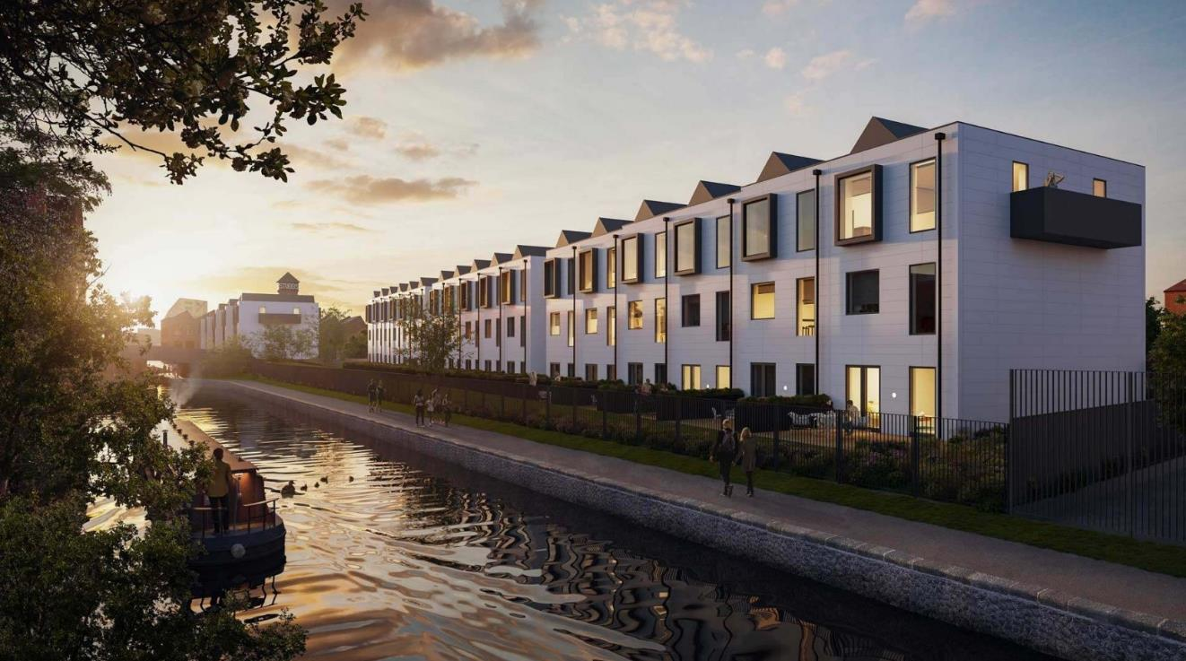
Project | New Islington Regeneration, Manchester
Client | Urban Splash
Architect | ShedKM
Sector | Low rise residential
System | Volumetric modular

Slide 7
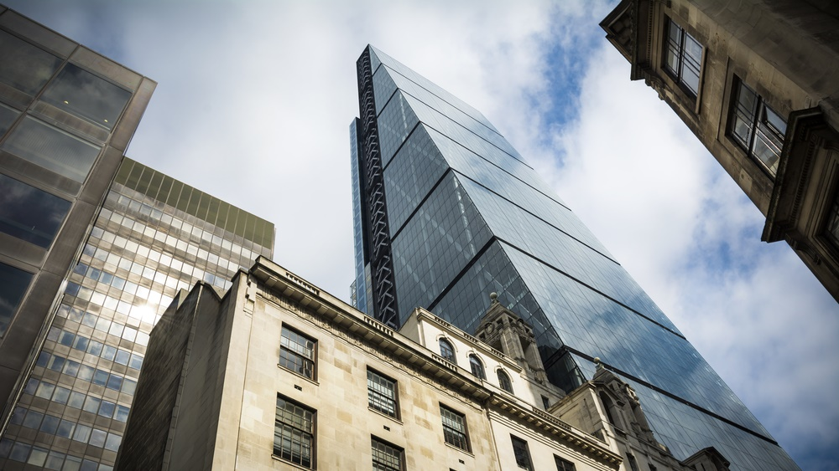
Project | 122 Leadenhall Street, London
Sector | Commercial
Designers | Rogers Stirk Harbour + Partners
Technology | Component and assembly prefabrication
Contractor | Laing O’Rourke

Slide 8
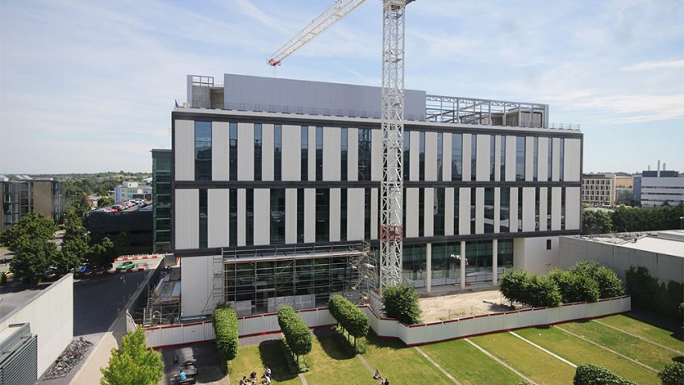
Project | Project Capella
Sector | Education
Designers | Nicholas Hare Architects
Technology | Pre-cast concrete
Constructor | Kier Construction
Specialist Contractor | PCE

Slide 9
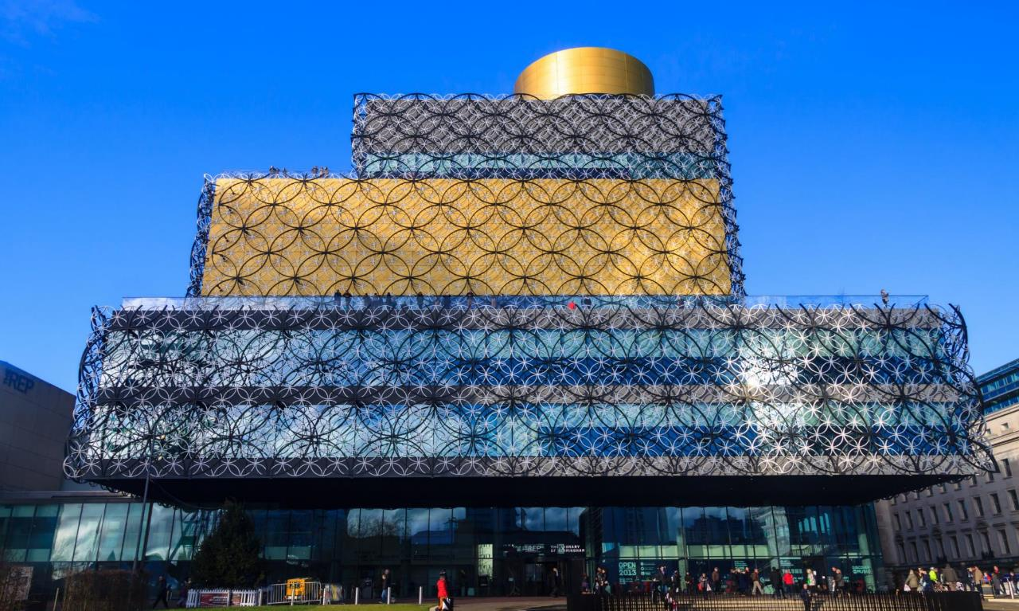
Project | Birmingham Central Library
Sector | Leisure and recreation
Designer | Mecanoo
Technology | Prefabricated façades
Supplier | Lindner Façades

Slide 10
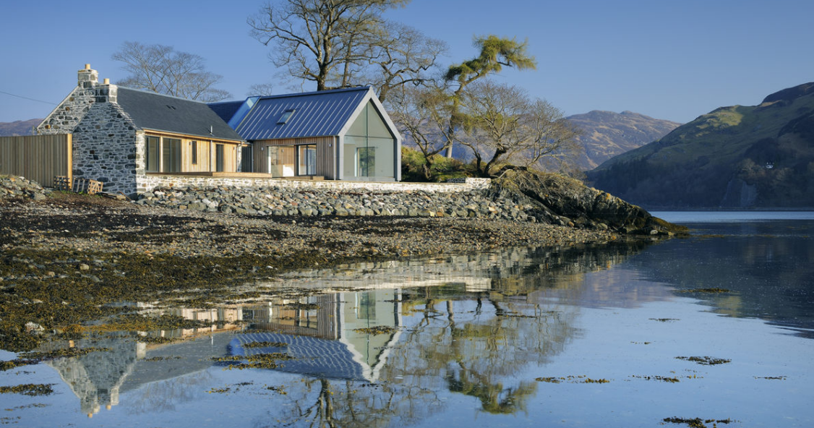
Project | R-house, Loch Duich, Scotland
Designer | Rural Design, Isle of Skye
Constructor | James MacQueen
Base unit cost | £120k for an R.1
System | Combination: open & closed timber panels plus roof cassettes

Slide 11

Project | Queensferry Crossing
Designer | Jacobs Arup
Sector | Infrastructure
Technology | Pre-fabricated bridge deck units

Slide 12
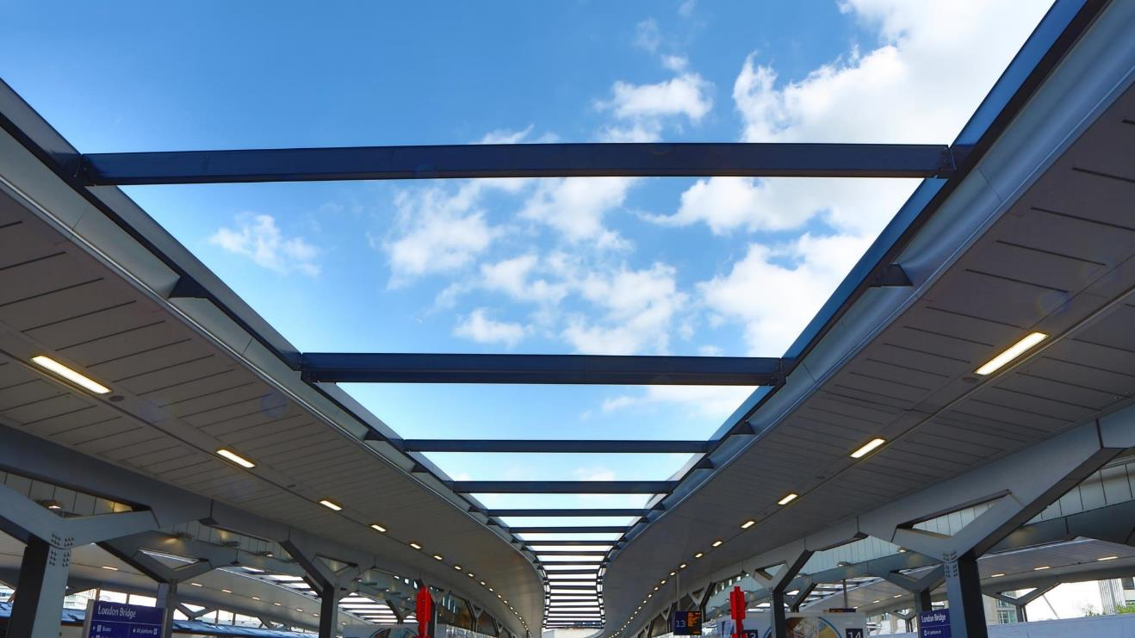
Project | London Bridge Station Modernisation
Client | Network Rail Thameslink Programme
Sector | Infrastructure
Technology | Offsite prototype assembly & pre-fabricated building services
Designer | Arcadis/WSP

