Slide 1
Contracting with National Highways – Guide A: Our Model Contracts
27 February 2024
Issue 2

Slide 2
Awareness Guides
We, the Contract Development and Assurance team (CD&A) within the Commercial and Procurement (C&P) Directorate of National Highways, have produced a series of Awareness Guides containing details on the conditions of contract and the Scope used in our contracts.
These Awareness Guides provide an introduction to common terms, requirements and background information on National Highways contracts. They are not intended to provide an in-depth explanation on all contractual terms or requirements.

Slide 3
Awareness Guide learning outcomes
Understand the role of the C&P Directorate and CD&A.
Understand the NEC4 contracts used by National Highways.
Understand how NEC4 contracts are amended to suit the requirements of National Highways.
Understand the differences between long and short forms of contact.
Understand how a Framework contract is structured.
Awareness Guide A:
45 minutes

Slide 4
New Engineering Contract 4 (NEC4) key terminology
For Engineering and Construction Contracts (ECC) and Engineering and Construction Short Contracts (ECSC) the following terms are used: Client, Contractor, Project Manager (not used in ECSC), Supervisor, works, Provide the Works.
For Professional Service Contracts (PSC) and Professional Service Short Contracts (PSSC) the following terms are used: Client, Consultant, Service Manager (not used in PSSC), service, Provide the Service.
For Term Service Contracts (TSC) and Term Service Short Contracts (TSSC) the following terms are used: Client, Contractor, Service Manager (not used in TSSC), service, Provide the Service.
For Supply Contracts (SC) and Supply Short Contracts (SSC) the following terms are used: Purchaser, Supplier, Supply Manager (not used in SSC), goods and services, Provide the Goods and Services.
Framework Contract (FC) uses a variety of terms which are described in detail later in this Awareness Guide.

Slide 5
Who are Contract Development & Assurance (CD&A) and what do they do?

Slide 6
Commercial Development Division
National Highways is the government company which plans, designs, builds, operates and maintains England’s motorways and major A-roads, known as the strategic road network.
The Commercial Development Division within National Highways ensure the best suited commercial and procurement solutions are utilised.
The Commercial Development Division are further organised into nine divisions as shown on the next slide.
The Contract Development and Assurance team are a team within Commercial Development that lead contract development and drafting across National Highways.

Slide 7
Commercial Development Division
Commercial Development Division
Procurement
Strategic Procurement
Digital Services & Technology
Asset Delivery
Lower Themes Crossing
Regional Investment Programme Procurement
Corporate Services
Supplier Performance
Supplier Intelligence
Strategic Support
Supply Chain
Commercial Services
Commercial Delivery – Operations
Commercial Delivery – Major Projects
Lower Themes Crossing
Commercial Development and Transformation
Supplier Development
Strategic Leadership & Direction
Supplier Relationship Management
Cost Planning
Commercial Intelligence
Commercial Resolution
Strategic Utility Services
Commercial Delivery Services
Commercial Governance
Contract Development and Assurance
Pre-Contract Commercial Services
Graduate & Apprentice Placement Programme

Slide 8
Contract Development & Assurance
The purpose of CD&A is to ensure that National Highways have commercially and legally robust contracts to deliver outcomes for National Highways safely and for the best value.
CD&A are considered contract experts and subject matter advisors where:
New Engineering Contract (NEC) forms are required,
Expertise is required to develop non-NEC forms, or
Assurance is required to develop non-NEC forms.
From the pre-procurement stage through to the contract mobilisation stage, CD&A support National Highways stakeholders with:
Responses to contract tender queries,
Awareness,
Education,
Training,
Post-award activities such as Deeds of Variations or S278s, and
Compilation of bespoke contracts.

Slide 9
Contract Development & Assurance
CD&A work collaboratively to draft contract documents to deliver the priorities of National Highways and the wider Government agenda.
CD&A work to:
Identify and define the contractual mechanisms to fulfil the business need including incorporating lessons learnt and best practice from previous procurements,
Establish and maintain a base-set of model contracts that help to standardise and provide uniformity across National Highways procurements,
Provide guidance, awareness, support and training to stakeholders on the contractual requirements throughout the contract cycle, and
Provide assured, commercially robust and legally compliant documents to fulfil National Highways needs.
CD&A own and maintain the model contract documents, these are conditions of contract based on NEC4 which include National Highways corporate requirements. Project specific details are required to be added to the models before a contract is published.

Slide 10
Preparation of contracts
CD&A lead on the development of:
The conditions of contract,
The Scope,
Framework Information (if a framework is used), and
Any supporting documentation.
CD&A, Procurement Delivery and Commercial liaise with subject matter advisors, as necessary.
CD&A produce and maintain the model contract documents. These models are based on NEC4 and include National Highways specific requirements.
The model documents ensure government policies and National Highways corporate requirements are included in all contracts whilst also including standardisation of contracts and contractual terms through different forms of contract.
Model contracts (including the Scope and Z clauses) are reviewed and updated every 6 months

Slide 11
NEC Contracts

Slide 12
New Engineering Contract (NEC4)
The NEC is a suite of published contracts created for and used by the construction industry. The NEC contracts are based around three principles which are:
they stimulate good management of the relationship between the two parties to the contract and, therefore, of the work involved in the contract.
they can be used in a diverse range of commercial situations, for a wide variety of types of work and in any location around the world.
they are clear, simple and written in plain English, using language and a structure which is straightforward and easily understood.
The NEC contracts are published by Thomas Telford (https://www.neccontract.com/products/books) and training is available from https://www.neccontract.com/products/training

Slide 13
All NEC4 contracts are designed around the following principles:
Flexibility
NEC contracts can be used in a wide variety of commercial situations, for procuring a diverse range of works, services, and/or goods.
Simplicity
They are clear, simple and written in plain English, using language which is straightforward and easily understood.
Stimulus to good management
They stimulate good management of the relationship between the contracting Parties and therefore of the work involved in the contract.
They are based on the idea that cooperative management of the interactions between the Parties can reduce the risks inherent in delivering the work involved in the contract.

Slide 14
National Highways NEC4 model contract documents
NEC4 contract types
Works
Services
Supply
Other
Engineering and Construction Contract (ECC)
Professional Service Contract (PSC)
Supply Contract (SC)**
Framework Contract (FC)**
National Highways
NEC4 model contracts
Professional Service Short Contract (PSSC)
Supply Short Contract (SSC)**
Engineering and Construction Short Contract (ECSC)
Term Service Contract (TSC)*
**Under development by CD&A
Term Service Short Contract (TSSC)*
Engineering and Construction Subcontract (ECS)
Professional Service Subcontract (PSS)
Dispute Resolution Service Contract (DRSC)
Engineering and Construction Short Subcontract (ECSS)
Term Service Subcontract (TSS)
Facilities Management Contract (FMC)
Facilities Management Short Contract (FMSC)
Facilities Management Subcontract (FMS)
*NEC standard guidance suggests the TSC and TSSC are used for facilities management. At National Highways, the TSC and TSSC are used for services and/or works and the model contract documents are currently set up for construction and design.
Facilities Management Short Subcontract (FMSS)
Alliance Contract (ALC)
Design Build Operate (DBO)

Slide 15
National Highways model contract documents supplement the NEC published contracts
NEC4 published contracts
National Highways NEC4 model contracts
Compiled contracts
The NEC4 suite of published contracts are industry standard contracts.
National Highways have developed model contract documents for some of the contracts in the NEC4 suite.
These tailor the industry standard to National Highways’ specific requirements.
The model contract documents require compilation to make the model contract documents specific to the intended project.

Slide 16
Long and short form of contract
Many of the forms of contract in the NEC suite have a “long form” and “short form” of contract.
For example the Engineering and Construction Contract (ECC) is a long form of contract.
A short form of contract has been produced by NEC, for example the Engineering and Construction Short Contract.
The short form contracts are intended for works/service/goods that do not require sophisticated management techniques and impose only low risk on both Client/Purchaser and Contractor/Consultant/Supplier.

Slide 17
Long form of contract

Slide 18
National Highways NEC4 model contracts - overview:
Engineering and Construction Contract (ECC)
This contract should be used for the appointment of a Contractor for engineering and construction work, including any level of design responsibility.
This contract is used for physical engineering or construction work on projects and is used by National Highways in Major Projects and Operational Directorates to improve the Strategic Road Network (SRN) through construction schemes.
Examples:
Regional Delivery Partner – Delivery Integration Partner framework
Scheme Delivery Framework – Civil engineering lots

Slide 19
National Highways NEC4 model contracts - overview:
Professional Service Contract (PSC)
This contract should be used for the appointment of a Consultant to provide a professional service.
This includes appointing a Consultant to support scheme development, to advise on planning applications or for engaging legal advisors.
This form of contract is commonly used by National Highways to procure design work by Consultants.
Examples:
Lower Thames Crossing Technical Partner contract
Lower Thames Crossing Integration Partner contract
Scheme Delivery Framework – Design lot

Slide 20
National Highways NEC4 model contracts - overview:
Term Service Contract (TSC)
This contract should be used to appoint a Contractor for a period of time to manage and Provide a Service.
It is designed for use in a wide variety of situations including providing a service to a Client’s existing asset (e.g. building) or infrastructure (e.g. highway maintenance on the SRN), or providing services within an existing asset such as planned and unplanned maintenance, facilities management or catering.
The TSC is used to maintain an asset with only a modest amount of improvement or “betterment” through renewal and replacement.
Examples:
Archaeology framework
Maintenance & Response (M&R) contract

Slide 21
National Highways NEC4 model contracts - overview:
Supply Contract (SC)
This contract should be used to procure high-value goods and related services.
High-value goods may be individual items of high-cost low volume such as advanced road technologies or low-cost but high volume items such as road salt.

Slide 22
National Highways NEC4 model contracts - overview:
Other forms of NEC contract are available
Other forms of NEC contract are available but are rarely used by National Highways, these include:
Alliance Contract,
Design Build and Operate Contract,
Dispute Resolution Service Contract, and
Subcontract versions of ECC, PSC, TSC and SC are also available.
Short forms of ECC, PSC, TSC and SC are described later in this Awareness Guide.
Framework Contract is described later in this Awareness Guide.
Information presented in this Awareness Guide applies to ECC, PSC, TSC and SC unless otherwise stated
For further details or to purchase NEC4 contracts visit https://www.neccontract.com

Slide 23
Structure and Options in a NEC4 long form of contract

Slide 24
National Highways NEC4 contract structure: ECC, PSC, TSC and SC
Contract Documents | Detail
Form of Agreement | The Form of Agreement (by Deed) summarises the contract. It states all documents contained in the contract and is signed by the Parties.
NEC4 published contract | The NEC4 published contract contains the core clauses of the contract, which form part of the conditions of contract.
Contract Data Part 1 | Contract Data Part 1 states the conditions of the contract: Main Option clause (A-F ECC) and (A, C or E PSC or TSC) (not used with SC) Clause for resolving and avoiding disputes (W) (ECC, PSC and TSC) Secondary Option Clauses (X,Y) additional conditions of contract (Z)
Contract Data Part 2 | Contract Data Part 2 states the information provided by the Contractor/Consultant/Supplier which is specific to the particular contract.
Scope | The Scope and its Annexes describe the works / service / goods and services and state any constraints on how the Contractor/Consultant/Supplier Provide the Works / Provide the Service / Provides the Goods and Services.
Pricing Information | The Pricing Documents contain the information relating to the Main Option.

Slide 25
Conditions of Contract - Introduction
Conditions of Contract | Identified As | Detail
Main Option | A - F | The Main Option determines the payment mechanism and associated basic allocation of financial risk between the Parties. There are up to six Main Options to choose from depending on the chosen NEC4 contract.
Secondary Options | X, Y | Secondary Options are NEC defined options, please consult the NEC published contract. There are up to 28 options to choose from depending on the chosen NEC4 contract. The choice of Secondary Options depends on the requirements of the business.
Options for Resolving and Avoiding disputes | W | The Options for resolving and avoiding disputes are dependent on the adjudication process and whether or not the Housing Grants, Construction and Regeneration Act 1996 applies. There are up to three Options to choose from depending on the chosen NEC4 contract. Note: National Highways uses Option W2 as a default.
Additional conditions of contract | Z | National Highways’ bespoke conditions of contract and amendments to NEC core clauses.

Slide 26
Long form contracts structure
The conditions of contract are organised in the following structure
1. General
2. The Contractor’s main responsibilities
3. Time
4. Quality Management
5. Payment
6. Compensation Events
7. Title
8. Liabilities and insurance
9. Termination
ECC
1. General
2. The Consultant’s main responsibilities
3. Time
4. Quality Management
5. Payment
6. Compensation Events
7. Rights to material
8. Liabilities and insurance
9. Termination
PSC
1. General
2. The Contractor’s main responsibilities
3. Time
4. Quality Management
5. Payment
6. Compensation Events
7. Use of equipment, Plant and Materials
8. Liabilities and insurance
9. Termination
TSC
1. General
2. The Supplier’s main responsibilities
3. Time
4. Quality Management
5. Payment
6. Compensation Events
7. Title
8. Liabilities and insurance
9. Termination. Resolving and avoiding disputes
SC

Slide 27
Selecting the Appropriate Main Option
National Highways select the Main Option which is appropriate to the type of contract and aligned with the Commercial & Procurement Strategy.
Increasing Client Risk
A
B
C
D
E
Increasing Contractor / Consultant Risk
Option | Title | ECC | PSC | TSC | SC | Consideration(s)
A | Priced contract with Activity Schedule | ✓ | ✓ | ✓ (with price list) | X | For Priced contracts, the financial risk lies with the Contractor/Consultant. From a Client perspective, it is important to have an understanding of the full Scope of works/services and clarity of what you are asking the Contractor/Consultant for. This will allow the Contractor/Consultant to define and provide an efficient way of pricing.
B | Priced contract with Bill of Quantities | ✓ | X | X | X
Note: SC has no Main Options, instead the contract pricing mechanism is included within the conditions of contract.

Slide 28
Selecting the Appropriate Main Option
National Highways select the Main Option which is appropriate to the type of contract and aligned with the Commercial and Procurement Strategy.
Increasing Client Risk
A
B
C
D
E
Increasing Contractor / Consultant Risk
Option | Title | ECC | PSC | TSC | SC | Consideration(s)
C | Target contract with Activity Schedule | ✓ | ✓ | ✓ (with price list) | X | Target contract is the middle ground in terms of financial risk. The sharing of commercial risk between Client and Contractor/Consultant is defined by the share ranges that set out the pain/gain split.
D | Target contract with Bill of Quantities | ✓ | X | X | X
Note: SC has no Main Options, instead the contract pricing mechanism is included within the conditions of contract.

Slide 29
Selecting the Appropriate Main Option
National Highways select the Main Option which is appropriate to the type of contract and aligned with the Commercial and Procurement Strategy.
Increasing Client Risk
A
B
C
D
E
Increasing Contractor / Consultant Risk
Option | Title | ECC | PSC | TSC | SC | Consideration(s)
E | Cost Reimbursable contract | ✓ | ✓ (time based) | ✓ | X | In Cost Reimbursable contracts, the Client carries all of the financial risk. They are appropriate where there is a lack of definition of the Scope and its requirements.
F | Management contract | ✓ (ECC Only) | X | X | X | Essentially a Cost Reimbursable contract but risk allocation can be varied according to the Main Option for subcontracts as selected by the Contractor. Option F is not frequently used in National Highways.
Note: SC has no Main Options, instead the contract pricing mechanism is included within the conditions of contract.

Slide 30
Examples of Secondary Optional X Clauses applicable to ECC, PSC,TSC and SC
Secondary Option | ECC | PSC | TSC | SC | Purpose | Scenarios
X1: Price adjustment for inflation |  |  |  |  | X1 transfers the risk of inflation to the Client / Purchaser | Please note that X1 only applies to Main Options A, B, C, D. For contracts over short time periods, inflation will not be a consideration. X1 is usually not used if a contract is less than 2 years (although other factors are to be considered). For durations of less than 2 years, the Contractor/Consultant/Supplier should be able to forecast for changes and make allowance within their Prices. Any index selected needs to reflect the type of work being undertaken i.e. is it predominantly labour, construction, or a combination of both. The relationship between X1 and X2 should be considered, and where both are used, the Commercial Delivery Team should satisfy themselves that there is limited opportunity for a change in law that results in both a compensation event and an impact on Price adjustment indices.
X2: Changes in the law |  |  |  |  | X2 transfers the risk of a change in law after the Contract Date to the Client / Purchaser | X2 is only used where the contract is longer than 2 years. On shorter contracts changes to the law are unlikely or the Contractor/Consultant/Supplier should have been able to identify changes in legislation (these are typically advertised well in advance of coming into force) and should have made allowances in their prices. Option X2 provides that changes in the law after the Contract Date are compensation events. If it is desired to generally place the risk of changes in law (including rates of taxation) with the Contractor/Consultant/Supplier, Option X2 should not be used. Since most changes will be reflected within a price adjustment formula, the use of X2 should be considered where X1 is included. Please see the note in Option X1 above concerning the relationship between X1 and X2.

Slide 31
Examples of Secondary Optional X Clauses applicable to ECC, PSC, TSC and SC
Secondary Option | ECC | PSC | TSC | SC | Purpose | Scenarios
X7: Delay damages |  |  |  |  | Requires the Contractor / Consultant / Supplier to pay liquidated damages if it fails to complete the works or service by the Completion Date. | Where Option X7 is used to incentivise Completion on time. Consider whether Completion after the Completion Date is acceptable to National Highways and if any additional costs would be incurred. By law, delay damages cannot be punitive and must be quantifiable and justified. It is therefore only possible to set an amount if the cost to National Highways is quantifiable and a genuine pre-estimate of the loss. Delay Damages are not preferred in National Highways contracts (or sub-contracts) due to the perception of encouraging undesirable behaviours.
X10: Information modelling |  |  |  |  | Mandatory for all contracts that need to meet Building Information Modelling (BIM) requirements | Please refer to the baseline BIM requirements in the Scope and as aligned to each contract type. X10 always applies for construction projects but may require amendments by CD&A for PSC contracts if design is involved.

Slide 32
Examples of Secondary Optional X Clauses applicable to ECC, PSC, TSC and SC
Secondary Option | ECC | PSC | TSC | SC | Purpose | Scenarios
X12: Multiparty collaboration |  |  |  |  | Allows for collective incentivisation | Consider whether the works are to be delivered by multiple Contractors/Consultants/Suppliers and it is desired to incentivise to formally deliver together. Consider whether Contractors/Consultants/Suppliers are delivering work that is inter-related and if the project is large enough to justify the increased level of administration. Please note X12 and X20 are not used together.
X18: Limitation of liability |  |  |  |  | Allows for limits to the Contractor’s liability to be included | Mandatory for National Highways contracts Limits of liability are to be stated in Contract Data Part One Option X18 clauses provide details of the excluded matters
X20: Key Performance Indicators |  |  |  |  | Allows for bi-lateral incentivisation | Please note X20 KPIs and normal performance requirements, as contained in the Collaborative Performance Framework (CPF), are separate and should not be combined. CPF is linked to general performance management under the contract. Please note Options X12 and X20 are not used together.

Slide 33
Examples of Secondary Optional X Clauses applicable to ECC, PSC, TSC and SC
Secondary Option | ECC | PSC | TSC | SC | Purpose | Scenarios
X22: Early Contractor Involvement |  |  |  |  | Appointing a Contractor at an early stage to help develop designs and proposals. | Please note that Option X22 is only used with Main Options C and E. Consider whether there is a benefit to encouraging the Contractor to be involved at an early stage to enable input into the scheme design. Consider resulting benefits such as reducing construction duration or cost where the project is phased and/or complex.

Slide 34
Y clauses
Option | Description | ECC | PSC | TSC | SC
Y(UK)1: Project Bank Account | National Highways’ policy is that Project Bank Accounts' (PBA) are used on all contracts across all directorate. This is to ensure access to timely payment by the supply chain in line with government payment timeframes. | ✓ | ✓ | ✓ | ✓
Y(UK)2: The Housing Grants, Construction and Regeneration Act 1996 | To be used if the UK Housing Grants, Construction & Regeneration Act 1996 applies. Please note that, the Act is quite wide in its application. Y(UK)2 is primarily applicable to construction, but may not only be constrained to ECC contracts. | ✓ | ✓ | ✓ | X
Y(UK)3: The Contracts (Right of Third Parties) Act 1999 | At National Highways it is mandatory to select Y(UK)3. Y(UK)3 allows a third party to enforce a term of the contract as identified in Contract Data. This Option can be used in addition to or as an alternative to undertakings to the Client or Others (X8). | ✓ | ✓ | ✓ | ✓

Slide 35
Options for resolving and avoiding disputes according to contract types
Option | Title and Description | ECC | PSC | TSC
W1 | Used where the Adjudication is the method of dispute resolution and the United Kingdom Housing Grants, Construction and Regeneration Act 1996 does not apply | ✓ | ✓ | ✓
W2 | Used where the Adjudication is the method of dispute resolution and the United Kingdom Housing Grants, Construction and Regeneration Act 1996 applies | ✓ | ✓ | ✓
W3 | Used where a Dispute Avoidance Board is the method of dispute resolution and the United Kingdom Housing Grants, Construction and Regeneration Act 1996 does not apply | ✓
Note:
For Options W1 & W2, the application of the UK Housing Grants, Construction and Regeneration Act 1996 must be fully understood.
National Highways generally use W2 for resolving and avoiding disputes.
Generally W3 is not used.
A Supply Contract (SC) has no W Options however the contract includes clauses in line with Option W1.

Slide 36
Additional conditions of contract (Z clauses)
These are introduced into the contract by the Client and can be used to amend or delete core clauses from the NEC4 conditions of contract.
Z clauses can also be used to introduce additional conditions of contract.
The appropriate Z clauses are drafted according to the selected contract and project requirements.

Slide 37
Z Clauses – Numbering Convention in National Highways contracts
Number | Explanation
Z1 – Z50 | Mandatory Z clauses which must be used in all contracts and are additional or amended conditions of contract needed to meet National Highways requirements. These can contain “red” text sections which require consideration from the contract drafter. Please note that Z21 – Z49 are not currently used, and are “blocked off” for future use.
Z51 – Z100 | Optional Z clauses which vary according to contract type.
Z100 + | Bespoke Z clauses.
Note:
If an optional Z clause is not required, the number of the Z clause is retained and the text “Not Used” is added.

Slide 38
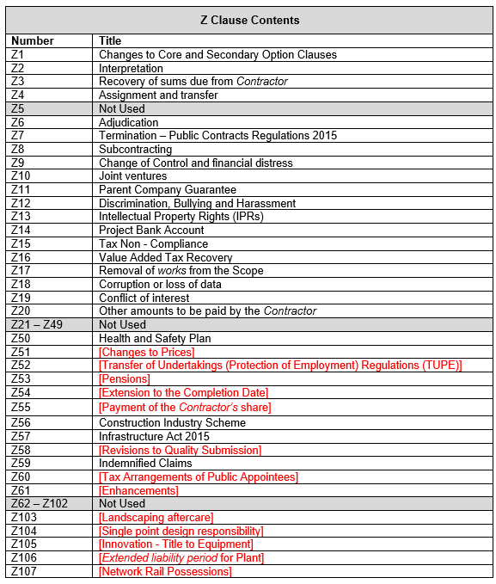
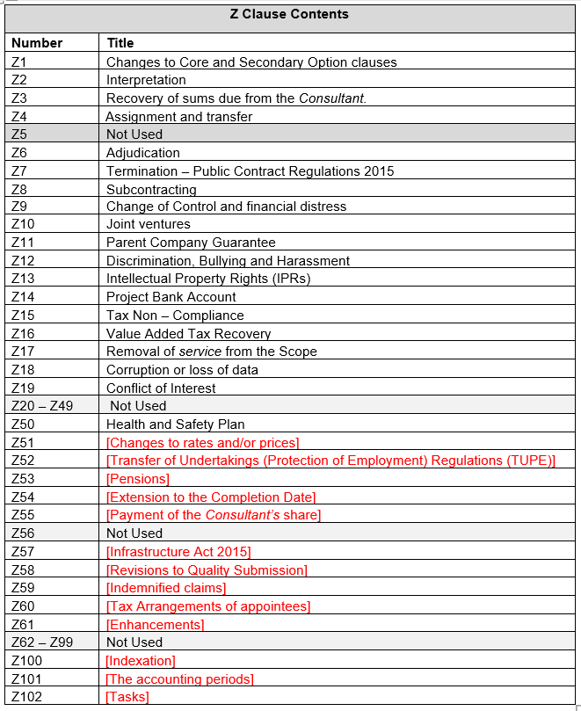
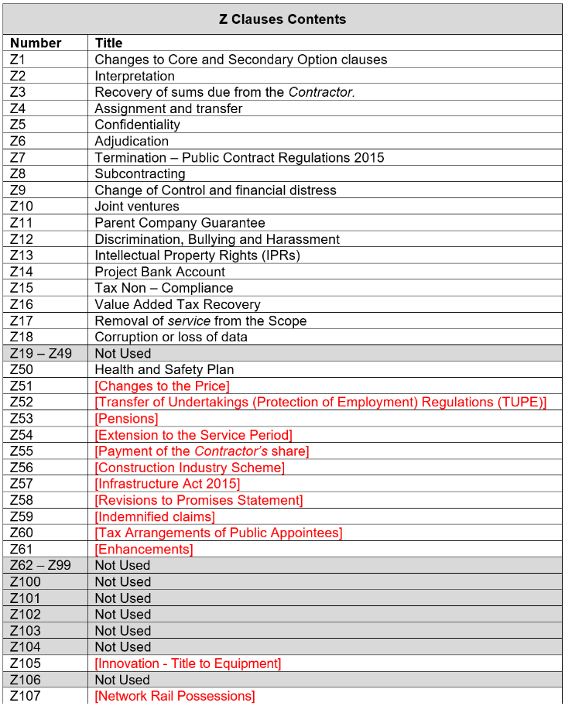
Overview of applicable Z clauses across ECC, PSC and TSC in the model contract documents.
ECC
PSC
TSC

Slide 39
Examples of mandatory Z Clauses
Number | Explanation
Z1 – Changes to core and secondary option clauses | Amends the NEC published contract and additional definitions to meet National Highways requirements.
Z13 – Intellectual Property Rights (IPRs) | Covers the provision for Intellectual Property Rights as part of the contract. National Highways own the Intellectual Property (IP) that is created as part of the contract with the Contractor/Consultant/Supplier, but not background IP. Z13 has two forms of drafting: the standard form which is applicable to most contracts, and the longer form, which is applicable to those contracts only where the main element of the contract is for developing software solutions.
Z20 – Other amounts to be paid by the Contractor | Clause Z20.2 requires the Contractor to incur the costs associated with recovery of a vehicle and is mandatory if section S 277 of the Scope is used. Clause Z20.3 requires the Contractor to incur the costs associated with repairing damaged or faulty technology, Plant and Materials. This clause is mandatory if section S 276 of the Scope is used.

Slide 40
Examples of optional Z Clauses
Number | Explanation
Z51 – Changes to Prices | Used with Option A or B only. Provides for an agreement between the Client and the Contractor to lower the prices. Failure to agree on a reduction to the prices will result in the Client being able to terminate the contract.
Z54 – Extension to the Completion Date | Used to permit changes to the Completion Date. Z54 is only to be included if an extension is an option.
Z55 – Payment of the Contractor’s share | Used with Option C or D. Limits the amount to be paid to the Contractor to the difference between the Price for Work Done to Date and the Total of the Prices and the assessment of the Contractor’s share to which they are entitled which is assessed by the Project Manager.

Slide 41
Short form of contract

Slide 42
National Highways NEC4 model contracts:
The short form contracts Engineering and Construction Short Contract (ECSC), Professional Services Short Contract (PSSC), Term Service Short Contract (TSSC) and Supply Short Contract (SSC) are alternatives to the ECC, PSC, TSC and SC are for straightforward works/service/goods.
The short form contracts are intended for works/service/goods that do not require sophisticated management techniques and impose only low risk on both Client/Purchaser and Contractor/Consultant/Supplier.
There are no Secondary Options.
Secondary Options required by National Highways for use in the short forms of contract are included as Z Clauses.
Standard National Highways Z Clauses are included as part of the additional conditions of contract.

Slide 43
Short form contracts – Main Options
The ECSC is used for physical engineering or construction work on projects.
The PSSC is used for the provision of professional services such as design or advice.
The TSSC is used to maintain an asset with only a modest amount of improvement of “betterment” through renewal and replacement, either as part of the main service or service under the Task Order provision which is a feature of the TSSC.
The SSC is used to provide goods and services.

Slide 44
Short form contracts – Main Options
The short form contracts do not have a choice of Main Options. ECSC, PSSC and TSSC use a Price List which can be used in two ways:
lump sum price for each item payable once it is complete, or
the actual measurement of those items with quantities (which can include units of time).
In addition to the above, the PSSC includes a provision for paying the Consultant for the hours worked using tendered rates.
The SSC uses a lump sum price for each item payable once it is complete/delivered.

Slide 45
Short form contracts structure
The contract comprises of a series of simplified templates to document the Contract Data and Scope.
The short form of contract also uses a simplified set of conditions of contract.
National Highways model contract documents include a Scope, Form of Agreement and Contract Data which also include project specific details.

Slide 46
National Highways NEC4 short form contract structure: ECSC, PSSC, TSSC and SSC
Contract Documents | Detail
Form of Agreement | The Form of Agreement summarises the contract. It states all documents contained in the contract, and is signed by the Parties.
NEC4 published contract | The NEC4 published contract contains the core clauses of the contract, which form part of the conditions of contract.
Contract Data | Including the Client’s/Purchaser’s Contract Data, the Contractor’s/Consultant’s/Supplier’s Contract Data and any additional Z Clauses
Scope | The Scope and its Annexes describe the works / service / goods and services and state any constraints on how the supplier Provides the Works / Provide the Service / Provide the Goods and Services.
Pricing Information | The Pricing Documents contain the information relating to the pricing mechanism used (lump sum or actual measurement of quantities).

Slide 47
Short form contracts structure
The conditions of contract are organised in the same structure as the long form versions
1. General
2. The Contractor’s main responsibilities
3. Time
4. Quality Management
5. Payment
6. Compensation Events
7. Title
8. Liabilities and insurance
9. Termination and resolving disputes
ECSC
1. General
2. The Consultant’s main responsibilities
3. Time
4. Quality Management
5. Payment
6. Compensation Events
7. Rights to material
8. Liabilities and insurance
9. Termination and resolving disputes
PSSC
1. General
2. The Contractor’s main responsibilities
3. Time
4. Quality Management
5. Payment
6. Compensation Events
7. Use of equipment and things
8. Liabilities and insurance
9. Termination and resolving disputes
TSSC
1. General
2. The Supplier’s main responsibilities
3. Time
4. Quality Management
5. Payment
6. Compensation Events
7. Title
8. Liabilities and insurance
9. Termination and resolving disputes
SSC

Slide 48
Conditions of contract comparison
The conditions of contract have been rationalised and condensed to suit a smaller and simplified Scope.
For example when describing the Contractor’s requirements to produce and update a programme under ECC and ECSC, the ECSC requirement is
But the ECC requirement is …
ECSC – Clause 31.1 The Contractor submits programmes to the Client as stated in the Scope.

Slide 49
Conditions of contract comparison
ECC – Clause 31.1 If a programme is not identified in the Contract Data, the Contractor submits a first draft programme to the Project Manager for acceptance within the period stated in the Contract Data.
ECC – Clause 31.2 The Contractor shows on each programme submitted for acceptance
The starting date, access dates, Key Dates and Completion Date,
planned Completion,
the order and timing of the operations which the Contractor plans to do in order to Provide the Works,
the order and timing of the work of the Client and Others as last agreed with them by the Contractor or, if not so agreed, as stated in the Scope,
the dates when the Contractor plans to meet each Condition stated for the Key Dates and to complete other work needed to allow the Client and Others to do their work,
provision for
float,
time risk allowances,
health and safety requirements and
the procedures set out in the contract,
the dates when, in order to Provide the Works in accordance with the programme, the Contractor will need
access to a part of the Site if later than its access date,
acceptances,
Plant and Materials and other things to be provided by the Client and
information from Others,
for each operation, a statement of how the Contractor plans top do the work identifying the principal Equipment and other resources which will be used and
other information which the Scope requires the Contractor to show on a programme submitted for acceptance.
ECC – Clause 31.3 Within two weeks of the Contractor submitting a programme for acceptance, the Project Manager notifies the Contractor of the acceptance of the programme or the reasons for not accepting it. A reason for not accepting a programme is that
The Contractor’s plans which it shows are not practicable,
It does not show the information which the contract requires
It does not represent the Contractor's plans realistically or
It does not comply with the Scope.
If the Project Manager does not notify acceptance or non-acceptance within the time allowed, the Contractor may notify the Project Manager of that failure. If the failure continues for a further one week after the Contractor’s notification it is treated as acceptance by the Project Manager of the programme.

Slide 50
Examples of using short form contracts
ECSC
Ingrebourne Valley Limited contract on Lower Thames Crossing. This was a simple scope of works primarily consisting of moving soil and flattening the ground to make it fit for purpose for when material from the tunnels was removed.
PSSC
Lower Thames Crossing Cadent Contestable Design had a short duration and simple scope of works.
Archaeology contract for preparation work using work orders and time charge orders.
TSSC
Archaeology Framework for A303. This was used to provide the option to do task orders for simple scopes of work. This contract had a nine year contract term where the full scope of work over this duration was unknown at the time of tender.

Slide 51
Structure and Options in a NEC4 short form of contract

Slide 52
Additional Clauses
Secondary Options are not used in short form contracts.
Optional entries are included within the Contract Data to replicate some of the long form additional clauses as follows:
Other items such as the use of an ultimate holding company guarantee (Option X4) in ECC are included as a Z Clause (Z11) in ECSC.
Optional Entry | Long Form Clause | ECSC | PSSC | TSSC | SSC
Price adjustment for inflation | X1 |  |  | ✓
Delay damages | X7 | ✓ | ✓ |  | ✓
Retention | X16 | ✓
The United Kingdom Housing Grants, Construction and Regeneration Act (1996) does apply, including the use of adjudication | W2 | ✓ | ✓ | ✓
Additional conditions | Z | ✓ | ✓ | ✓ | ✓

Slide 53
Z Clauses – numbering convention
Number | Explanation
Z1 – Z50 | Mandatory Z clauses which must be used in all contracts and are additional or amended conditions of contract needed to meet National Highways requirements. These can contain “red” text sections which require consideration from the contract drafter. Please note that Z21 – Z49 are not currently used, and are “blocked off” for future use.
Z51 – Z100 | Optional Z clauses which vary according to contract type.
Z100 + | Bespoke Z clauses.
Note:
If an optional Z clause is not required, the number of the Z clause is retained and the text, “Not Used” is added.

Slide 54
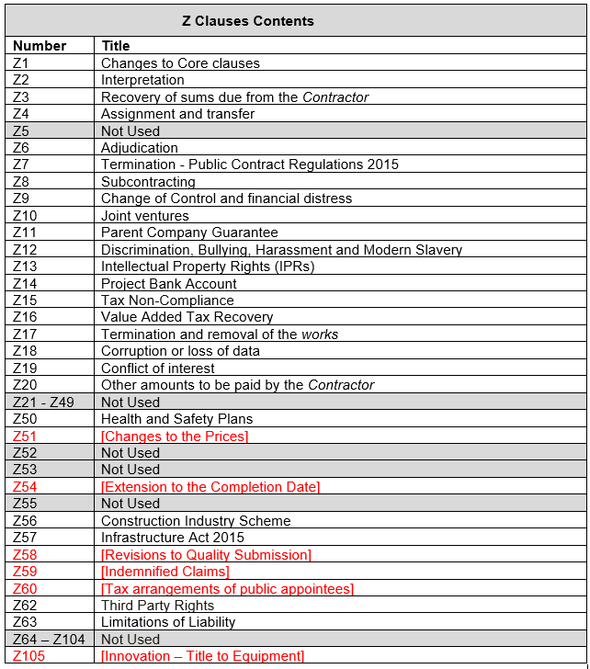
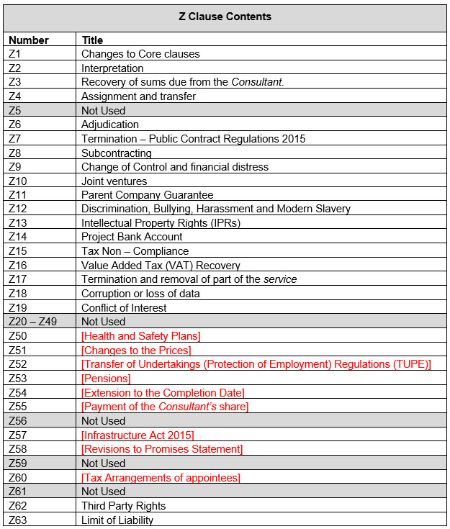
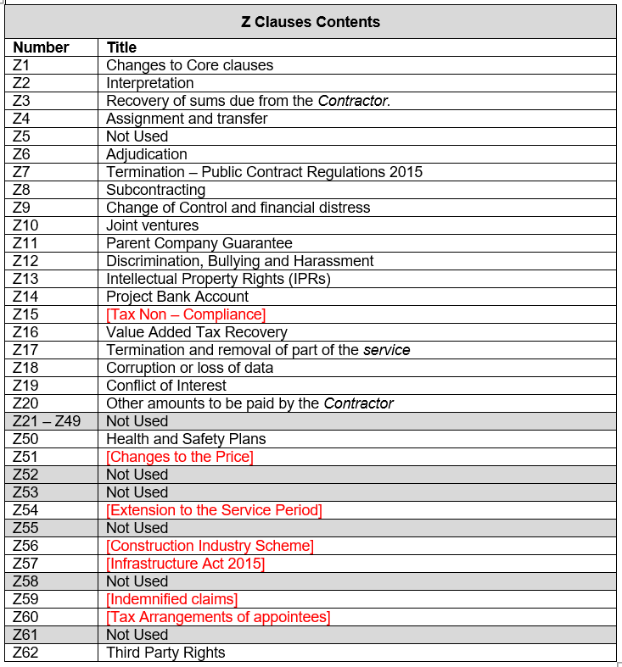
Overview of applicable Z clauses across ECSC, PSSC and TSSC in the model contract documents.
ECSC
PSSC
TSSC
Extract from Issue 6 Revision 0 contract.
Extract from Issue 6 Revision 0 contract.
Extract from Issue 6 Revision 0 contract.

Slide 55
Examples of mandatory Z Clauses
Number | Explanation
Z1 – Changes to core clauses | Amends the NEC published contract and additional definitions to meet National Highways requirements.
Z17 – Termination and removal of the works | This permits the Client to remove part or all of the remaining work. There is an optional clause which may be included permiting the Client to instruct the Contractor to Provide the Works outside the Site provided it will not prejudice the Contractor’s ability to comply with the contract.
Z20 – Other amounts to be paid by the Contractor | Requires a Contractor to incur the costs associated with the effects of exceeding the threshold for quality management points and other Scope sections. Clause Z20.2 requires the Contractor to incur the costs associated with recovery of a vehicle. Clause Z20.3 requires the Contractor to incur the costs associated with repairing damaged of faulty technology Plant and Materials.

Slide 56
Examples of optional Z Clauses
Number | Explanation
Z51 – Changes to Prices | Provides for an agreement between the Client and the Contractor to lower the prices. Failure to agree on a reduction to the prices will result in the Client being able to terminate the contract.
Z54 – Extension to the Completion Date | Conditions of contract to permit changes to the Completion Date. Z54 is only to be included if an extension is an option.

Slide 57
Framework contracts

Slide 58
National Highways NEC4 model contracts:
Framework Contract (FC)
Frameworks use the NEC4 Framework Contract at the highest level, and under the framework one of the NEC4 models is used for the Work Order (call off contract).
A Supplier or a number of Suppliers are awarded a place on a framework in order to carry-out work on an ‘as instructed’ basis or ‘competed’ basis over a set term. The work, ordered via a Work Order, Time Charge Order or Task Order, may be to:
provide works (using either the ECC or ECSC), or
provide services (using the PSC, PSSC, TSC, TSSC or SC),
Note, there are no NEC Main Options (payment mechanism) at framework level, these only apply at Work Order level in the Work Order Contract Data.

Slide 59
Structure of a Framework Contract
Framework Level
Contract Level
Work Order Level
Operation of the framework contract.
Documents include:
Individual packages of work issued to the Contractor/Consultant/Supplier providing project specific details and instruction to proceed.
Documents include:
Framework Contract Data
Framework Information
Sits beneath the framework level documents providing details of the work to be undertaken if/when instructed.
Conditions of contract for the appropriate form of contract (e.g. ECC, PSC)
Contract Data for the appropriate form of contract
Scope
Framework conditions of contract
Documents include:
Form of Agreement
Work Order
Task Order (used with TSC)
Some frameworks include a selection of project specific Work Orders grouped together. Please refer to specific framework conditions of contract for specific details.
Some frameworks use “package”, or “scheme” at Work Order level. Please refer to individual framework conditions of contract for specific naming conventions used.

Slide 60
Key content of a framework contract
Framework Level
Contract Level
Work Order Level
Framework operation including work allocation procedures
Common requirements to all work instructed under a Work Order
Description of the work or service to be undertaken/provided.
Project specific details including Site Information, risks, documents etc
General obligations of the Contractor/Consultant/ Supplier such as Parent Company Guarantee, continual improvement, skills & apprentices etc.
Requirements of the Contractor/Consultant/ Supplier if instructed under a Work Order e.g. Principal Contractor’s duties, payment and invoicing, risk management, environmental and sustainability etc.
General requirements of the Contractor/Consultant/ Supplier regardless of whether any work is ordered.
Contract requirements and Scope
Work Allocation between Contractors/Consultants/ Suppliers on the framework.
Pricing mechanism/rates.
Project specific pricing requirements.

Slide 61
Framework Lots
A framework may contain a series of Lots.
Each Lot can provide a type of work or service or cover a geographical area.
Each Lot can be divided into sublots. For example, a Lot can provide a service such as traffic management and a sublot splits this provision into geographical regions.
Lots and sublots can be awarded to multiple Contractors, Consultants or Suppliers in accordance with the published award criteria for the contract.
Splitting a framework into Lots and sublots encourages Small and Medium-sized Enterprises (SMEs) to participate in the tender process by competing for work within their specialism at an appropriate scale for their business.
Frameworks must comply with the Public Contracts Regulations 2015 (Regulation 33) for framework agreements.

Slide 62
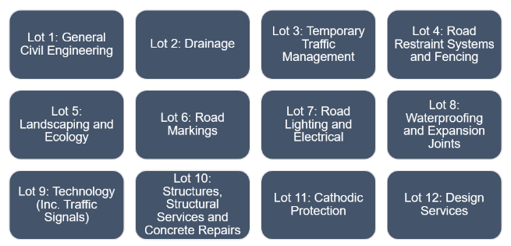
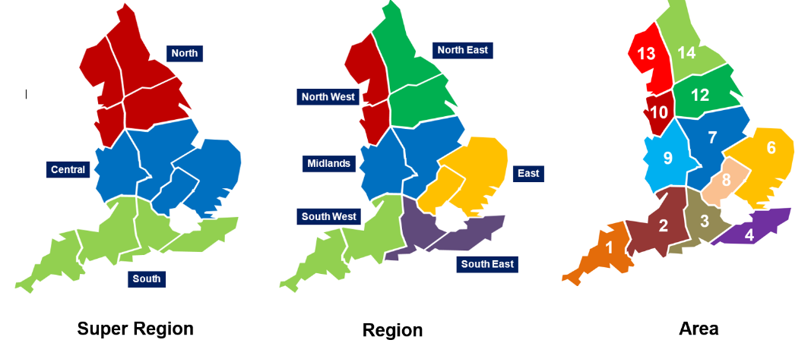
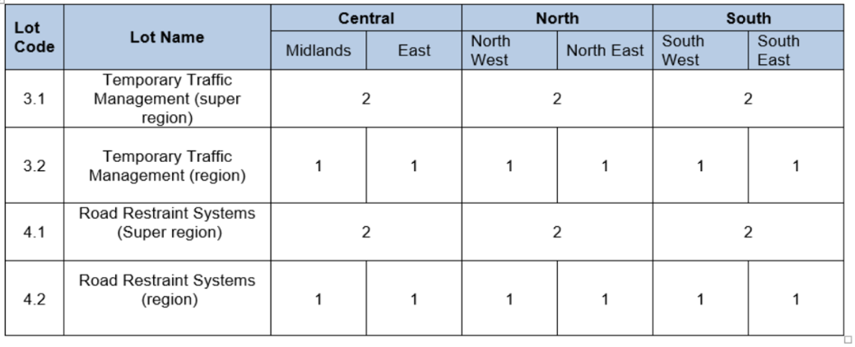
Example of framework Lots and sublots
The Scheme Delivery Framework has 12 Lots.
Each Lot is further divided into sublots covering specific geographic regions
Some sublots have multiple Contractors, others have a single Contractor (for example the SDF super regions as shown in the table bottom right).

Slide 63
Contract documents
Framework
Denotes framework level
Contract
Denotes contract level
Work Order
Denotes Work Order level
Levels are as described previously within this Awareness Guide under the structure of a framework contract

Slide 64
The Framework Information
Framework
The Framework Information is “information which specifies how the Parties work together It is identified in the Contract Data.
The Framework Information describes how work will be allocated to the Contractor/Consultant/Supplier and any necessary requirements and obligations on the Contractor/Consultant/Supplier.
For example employment of apprentices which is linked to spend through the framework rather than employment of apprentices on individual Work Orders.

Slide 65
The Framework Information
Framework
The Framework Information should detail how work is allocated to the Contractors/Consultants/Supplier for the duration of the framework. The method of doing so will suit the work being delivered through the framework but may also be based on:
annual allocation of packages of work comprising of multiple Work Orders,
packages of work grouped together to provide efficiency in delivery,
commitments made for work share between Contractors/Consultants/Supplier at the time of tender,
consideration of Contractor/Consultant/Supplier performance, capacity and capability, and
geographical locations of the work.

Slide 66
The Framework Information
Framework
For example the Framework Information may contain:
The purpose and objectives of the framework.
Details of the framework including its structure and the number of Contractors, Consultants or Suppliers appointed.
Details of the work allocation and quotation procedures.
Details of how the Parties will work together which may include:
The number, purpose and frequency of meetings the Contractor/Consultant/Supplier attends and who attends.
Whether the Contractor/Consultant/Supplier identifies a person as its representative.
Contractor/Consultant/Supplier performance review and measurement requirements.
Communication system to be used e.g Primavera, CEMAR etc.

Slide 67
Framework Information contents
Framework
The Framework Information is tailored to the work or service being procured.
Example section headings of the Framework Information
Client’s Vision and Objectives | Framework Scope | Framework Structure | Early Contractor Involvement | Work Order Allocation (developed by Procurement Delivery)
Value Order Procedure | Contractor/Consultant/ Supplier Ineligibility | Secondary Competition | Quotation Procedure | Pricing Rules
Information systems | Security | Software and Licences | Quality Management System | Health and Safety
Audits | Supply Chain Maturity Matrix Action Plan | Hazardous Materials | Payment | Equality & Diversity

Slide 68
Framework Information
Framework
The framework contract could contain multiple NEC contracts (e.g. ECC and PSC). The Framework Information must be compatible with any form of contract applicable to that framework contract. For example the Scheme Delivery Framework uses both ECC for Lots 1-11 and PSC for Lot 12 (design).
The Framework Contract may use the term Supplier to refer to both a Contractor or Consultant depending on the applicable form of contract which is used to Provide the Works or Service i.e. ECC or PSC.

Slide 69
Compiling the Scope
Contract
A Scope is prepared by CD&A for each NEC contract (e.g. ECC, PSC etc).
The Scope is compiled using the model contract documents and is amended to suit the framework contract.
Where a requirement in the model Scope has been included in the Framework Information the Scope is amended to read “Refer to Framework Information” including a reference to the relevant section or clause within the Framework Information.
Example from Pavement Delivery Framework 2022 ECC Scope

Slide 70
Compiling the Scope
Contract
When compiling the Scope, some required information will be project specific.
Project specific information is provided in the Work Order.
Where this is the case, a statement to this effect is included the Scope.
Example from Pavement Delivery Framework 2022 ECC Scope

Slide 71
Compiling the Work Order
Work Order
A Work Order template is prepared by CD&A when drafting the contract documents.
The Work Order template is included in the document set issued at tender, typically within the Framework Information Appendix 2 Reference Documents.
The template is intended to support operation of the framework and ensure that the Work Order is complete and includes all required items (to avoid anything being missed during call-off).
The template also lists the project specific details required for pricing the works including Scope, drawings, specifications etc.

Slide 72
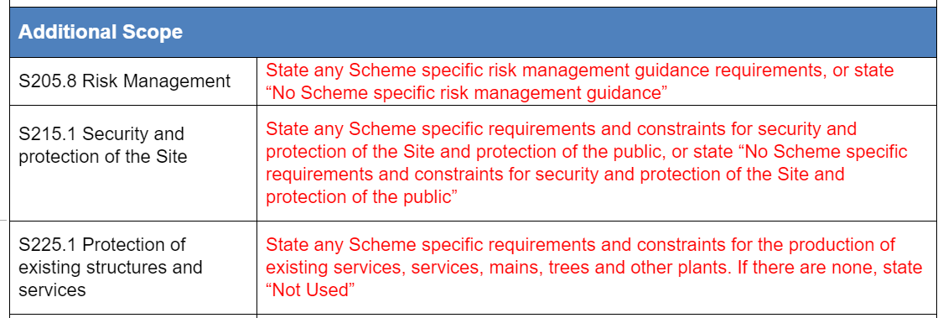
Compiling the Work Order
Work Order
The Work Order lists out each clause in the Scope where the Scope references information to be provided in the Work Order.
Each of these sections must be populated by National Highways in the Work Order, providing project specific details or, where identified, “Not Used” may be inserted (e.g. S225.1).
Example from Pavement Delivery Framework 2022 Work Order template

Slide 73
Scope vs Work Order
The contract level Scope (e.g. the ECC Scope) describes the requirements of the Contractor and are common to all Work Orders.
The Work Order states which elements of the Scope are applicable for each individual Work Order.
Scope
Work Order
States if the Contractor is to perform the role of Principal Contractor or not
States if Early Contractor Involvement is required or not
Describes the provision of Early Contractor Involvement services
Describes the Contractor’s duties as Principal Contractor

Slide 74
Awareness Guide learning outcomes recap
You should now:
Understand the role of CD&A and the C&P Directorate.
Understand the different NEC4 contracts.
Understand the NEC4 contracts used by National Highways.
Understand the differences between long and short forms of contact.
Understand how a Framework contract is structured.

Slide 75
For further questions please visit

Slide 76
NEC4 common terms
Initials | Form of contract | National Highways | Provider of goods, services or works | Other roles within the contract | Specification includes: | End of the contract
ECC | Engineering & Construction Contract | The Client | The Contractor | The Project Manager & The Supervisor | The Scope, the works, Providing the Works | At Completion
PSC | Professional Service Contract | The Client | The Consultant | The Service Manager | The Scope, the service, Providing the Service | At Completion
TSC | Term Service Contract | The Client | The Contractor | The Service Manager | The Scope, the service, Providing the Service | Until the end of the Service Period of the Affected Property
SC | Supply Contract | The Purchaser | The Supplier | The Supply Manager | The Scope, the goods or services, Providing the Goods and Services | At Delivery

Slide 77
NEC4 common terms
Initials | Form of contract | National Highways | Provider of goods, services or works | Specification includes: | End of the contract
ECSC | Engineering & Construction Short Contract | The Client | The Contractor | The Scope, the works, Providing the Works | At Completion
PSSC | Professional Service Short Contract | The Client | The Consultant | The Scope, the service, Providing the Service | At Completion
TSSC | Term Service Short Contract | The Client | The Contractor | The Scope, the service, Providing the Service | Until the end of the Service Period of the Affected Property
SSC | Supply Short Contract | The Purchaser | The Supplier | The Scope, the goods or services, Providing the Goods and Services | At Delivery

Slide 78
Glossary of terms
“Black” text: text in the model contract documents which may not be amended without agreement of CD&A.
Collaborative Delivery Framework (CDF): National Highways framework for collaboration between Suppliers.
Collaborative Performance Framework (CPF): National Highways collaboration toolkit.
Commercial Delivery (CD): team within National Highways.
Commercial Modelling (CM): team within National Highways
Commercial and Procurement Strategy (CPS): strategy for the development and procurement of a contract within National Highways.
Conditions of contract: the contract clauses including NEC4 and National Highways Z clauses.

Slide 79
Glossary of terms
Contract Data: forms part of the conditions of contract.
Contract Development and Assurance (CD&A).
Defined terms (capitalised): definition of term provided in NEC contract, National Highways Clause Z1 or Annex 01 of the Scope.
Identified terms (italics): terms identified in Contract Data Parts One and Two e.g. Contractor, Site.
Invitation to Tender (ITT): instructions issued to the Contractor, Consultant or Supplier giving details of the procurement process and tender opportunity.
Key Performance Indicator (KPI): contractual incentives for monitoring and promoting good performance, or disincentives for poor performance.
Model contract document: contract documents incorporating National Highways standard requirements.

Slide 80
Glossary of terms
New Engineering Contract (4th edition) (NEC4): suite of contracts published by the ICE which includes:
ECC: Engineering and Construction Contract,
ECSC: Engineering and Construction Short Contract,
PSC: Professional Service Contract,
PSSC: Professional Service Short Contract,
TSC: Term Service Contract,
TSSC: Term Service Short Contract,
FC: Framework Contract,
SC: Supply Contract, and
other contracts within the NEC4 suite are rarely used by National Highways.

Slide 81
Glossary of terms
Package Order: used on some Framework Contracts to describe a group of work/task orders awarded to the same Supplier.
Procurement Delivery Group (PDG): National Highways group which steers the development of the Commercial and Procurement Strategy (CPS).
Procurement Division (PD): team within National Highways.
Project Control Framework (PCF): method for managing and delivering Major Projects within National Highways. “Red” text: text in the model contract documents which may be altered by the Compiler. Safety Engineering and Standards Directorate (SES): directorate within National Highways.
Selection Questionnaire (SQ): questionnaire used during tender.
Small and Medium-sized Enterprises (SMEs): small and medium sized suppliers to National Highways.

Slide 82
Glossary of terms
Strategic Road Network (SRN): highway network managed by National Highways.
Subject matter advisors (SMA): advisors from within National Highways with an expertise in defined areas e.g. pavements, carbon, sustainability etc.
Task Order: used in some Framework Contracts to define a piece of work awarded to the Contractor e.g. undertake a survey or design a new junction.
Tender commitments: written commitments made by tenderers which are incorporated into the contract and monitored and assessed during the contract period.
Time Charge Order: used in some Framework Contracts to instruct a Supplier to work on a project. Often used where a Scope of works cannot be well defined e.g. Early Contractor Involvement (ECI).
Tribunal: form of dispute resolution (e.g. arbitration or adjudication).

Slide 83
Glossary of terms
Work Order: used in some Framework Contracts to define a piece of work awarded to the Contractor. E.g. undertake a survey or design a new junction.
Z Clauses: clauses written by the Client which add to, remove, replace or amend existing NEC contract clauses.

