Slide 1
Contracting with National Highways – Guide C: Quality, Insurance & Liabilities
23 February 2024
Issue 1

Slide 2
Awareness Guides
We, the Contract Development and Assurance team (CD&A) within the Commercial and Procurement (C&P) Directorate of National Highways, have produced a series of Awareness Guides containing details on the conditions of contract and the Scope used in our contracts.
These Awareness Guides provide an introduction to common terms, requirements and background information on National Highways contracts. They are not intended to provide an in-depth explanation on all contractual terms or requirements.
This guide has been produced to answer some of the common questions posed to National Highways from Suppliers regarding insurance, liability and quality requirements in a contract.

Slide 3
Awareness Guide learning outcomes
Understand insurance and liability requirements and levels.
Understand quality management requirements in National Highways contracts.
Awareness Guide C:
40 minutes

Slide 4
New Engineering Contract 4 (NEC4) key terminology
For Engineering and Construction Contracts (ECC) and Engineering and Construction Short Contracts (ECSC) the following terms are used: Client, Contractor, Project Manager (not used in ECSC), Supervisor, works, Provide the Works.
For Professional Service Contracts (PSC) and Professional Service Short Contracts (PSSC) the following terms are used: Client, Consultant, Service Manager (not used in PSSC), service, Provide the Service.
For Term Service Contracts (TSC) and Term Service Short Contracts (TSSC) the following terms are used: Client, Contractor, Service Manager (not used in TSSC), service, Provide the Service.
For Supply Contracts (SC) and Supply Short Contracts (SSC) the following terms are used: Purchaser, Supplier, Supply Manager (not used in SSC), goods and services, Provide the Goods and Services.
Framework Contract (FC) uses a variety of terms which are described in detail later in this Awareness Guide.

Slide 5
Insurance and liability definitions

Slide 6
Introduction
What is insurance?
Insurance is a method of transferring the financial cost arising from a specified risk to a third party (insurer) in return for a premium. There are many types of insurance policies, those relevant to contracts used by National Highways include Third Party Liability Insurance, Contractors All Risk Insurance, Employers Liability Insurance, Professional Indemnity Insurance, Motor Third Party Insurance and Contractors Pollution Liability Insurance.
What is liability?
To be legally responsible for, or to be “at fault”
What is indemnity?
Security or protection against a loss or financial burden.
Describes who is responsible for specific damages that arise out of a loss.
Insurance and liability for a contract are recorded in Contract Data Part 1 and in the insurance Annex of the Scope.
The level of insurance required and the liability required must not be confused - they are two very different issues as described on the following slides.

Slide 7
Insurance, Indemnity and Liability
Insurance | Indemnity | Liability
A policy transferring risk to an insurer in exchange for payment. It guards the insured party against losses for any risks specified in the policy. | A contractual obligation for one party to provide compensation to another party when that party has suffered a loss. | A situation where one party is legally responsible for something.
Careful attention to the policy terms is required including notification periods, for example, some policies require the insurer to be notified of an insured event within 28 days. | For example, when a business is sold, the vendors may give an indemnity to the purchasers in respect of any claims that arise from the period in which the vendors were in control of the business | Usually resulting from terms contained in a contract, negligence or legislation.

Slide 8
Example types of insurance
Contractor’s/Property “All Risks” insurance
Third Party Public and Products Liability insurance
Employer’s Liability insurance
Professional Indemnity insurance
Other Third Party Liability insurances
Covers physical loss, destruction or damage by a peril covered by the policy to works under construction, plant, materials or equipment by any risk not excluded.
Example: damage to prefabricated bridge beam during installation. Insurance would cover costs incurred to repair damage
Covers damages that the insured is legally liable to pay, resulting from death, injury, illness to third parties or damage to third party property. Note this does not cover employees.
Example: member of the public struck by excavator arm. Insurance will indemnify the insured for damages and compensation that the insured is legally liable to pay to the third party.
Covers damages payable to employees injured or who become sick at work and for which their employer is legally liable.
Example: employee trips on site and injures their arm. Insurance would cover legal costs and damages that the employer is legally liable to pay.
Covers negligent acts, errors or omissions in connection with provision of professional services
Example: designer (not Contractor) makes a mistake in concrete mix design calculations. Insurance would cover additional costs and delays to fix the error once discovered on site to the extent that the insured is legally liable for such costs
Cover dependant on insurance policies
Example: motor third party liability insurance or Contractor’s Pollution Liability Insurance.
Project specific requirements
ECC Annex 03 Section 1.4
ECSC, PSC,PSSC, TSC and TSSC Annex 03 Section 1.3
ECC, ECSC, TSC and TSSC Annex 03 Section 1.1
ECC, ECSC, PSC, PSSC, TSC and TSSC Annex 03 Section 1.2
ECC, Annex 03 Section 1.3
PSC and PSSC Annex 03 Section 1.1

Slide 9
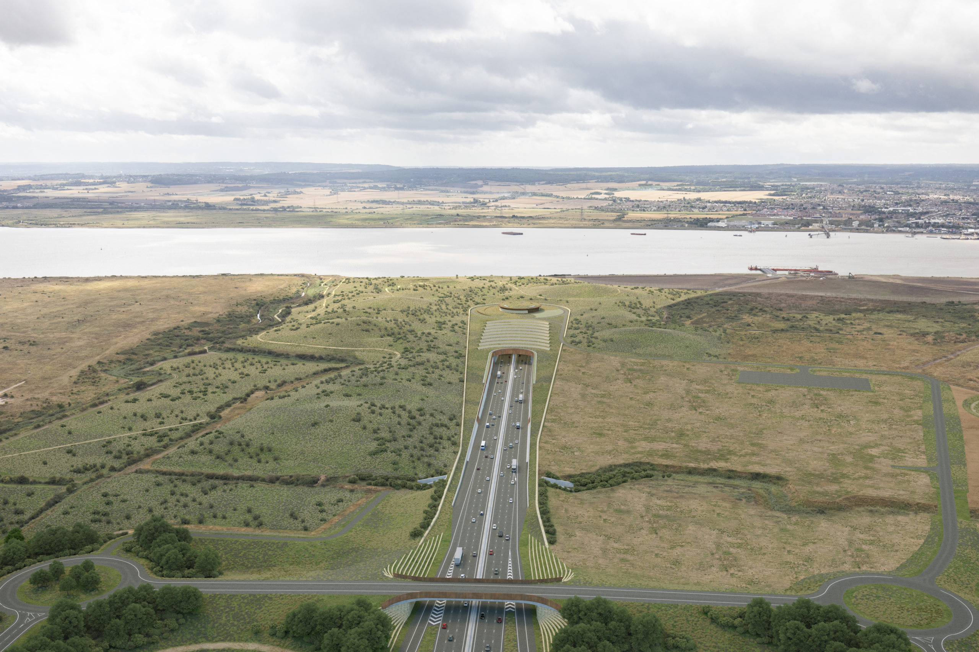
Other types of insurances
Project specific insurances may also be required.
Marine Cargo Insurance will be required for the transport of any equipment by sea or river.
Contractor’s Pollution Liability Insurance will be required to cover the insured legal liability to pay compensation or damages in the event of a pollution incident in connection with the execution of the works.

Slide 10
Limitation of liability
What is limitation of liability?
A cap on the exposure to risk.
If a contract does not state a cap on liability then the financial exposure to a Party will be unlimited and may be determined by the tribunal, regardless of the Party’s ability to pay or not.
To manage the financial exposure to risk a limitation of liability clause is inserted into the contract, in court a reasonable limitation of liability will usually be upheld.
The level of liability cap stipulated within the contract is an agreement between the Parties and is dependent on the Party’s appetite for risk.
It is of importance to note, the level of insurance indemnity stated in the contract does not limit a Party’s liability to that sum, the limitation of liability needs to be specifically stipulated.
National Highways do not currently require unlimited liability from their Suppliers.
It is important to note that events covered by insurance are excluded from the limits of liability in National Highways contracts via a modification to clause 18 (ECC) or equivalent.

Slide 11
Limit of liability, insurance level and risk
It is important to note that the events covered by insurance are excluded from the limits of liability in National Highways contracts via a modification to clause 18 (ECC) or equivalent.
The scope and level of insurance protection is an important feature and set out in the contract.
Any financial risk beyond the limitation of liability stated in the contract is borne by the Client as long as the Contractor/Consultant/Supplier is not in breach of the contract.
By the Client taking on some of the risk via the limit of liability, the Contractor/Consultant/Supplier’s exposure is capped and tender prices may be reduced.
The value of the insurance cover obtained against a particular risk does not limit liability in law, but limits only the amount of liability for a defined risk to be funded through insurance.
Total financial risk
NH’s risk
Contractor / Consultant Supplier’s limitation of liability
Contractor / Consultant / Supplier’s risk
Contractor / Consultant / Supplier’s insurance level
Contractor / Consultant / Supplier’s risk, which they have passed to a third party (an insurer)
Financial value of risk (£)
Contractor / Consultant Supplier’s deductible / excess*
Contractor / Consultant / Supplier’s risk
*Applicable to each and every occurrence / claim

Slide 12
Limit of liability, insurance level and risk
There may be occasions when the limitation of liability may be the same as the insurance level.
Insurance policies will contain a deductible/excess which will differ depending on policy conditions and the Contractor/Consultant/Supplier’s appetite for self funding insurance risks. The insurance market may also dictate minimum deductible payments.
Insurance policies may cover circumstances which cannot be limited by law. For example a public liability insurance will cover death or bodily injury to a third party, the liability for which cannot be capped.
The insurance level may apply for any one occurrence or claim, the number of occurrences or claims being unlimited or any one occurrence or claim in the aggregate per annum.
Total financial risk
NH’s risk
Contractor / Consultant Supplier’s limitation of liability
Contractor / Consultant / Supplier’s risk
Contractor / Consultant / Supplier’s insurance level
Contractor / Consultant / Supplier’s risk, which they have passed to a third party (an insurer)
Financial value of risk (£)
Contractor / Consultant Supplier’s deductible / excess*
Contractor / Consultant / Supplier’s risk
*Applicable to each and every occurrence / claim

Slide 13
Limit of liability, insurance level and risk
Total financial risk
The total financial risk on the graph is the value required to respond to the risk should it occur
NH’s risk
Contractor / Consultant Supplier’s limitation of liability
If the total financial risk value is higher than the limit of liability, the Client covers the difference.
Contractor / Consultant / Supplier’s risk
Contractor / Consultant / Supplier’s insurance level
Liability beyond the insurance value, and up to the limit of liability, is borne by the Contractor.
Contractor / Consultant / Supplier’s risk, which they have passed to a third party (an insurer)
The limit of liability is set in the contract. It could be higher or lower than the insurance level, depending on the client requirements and appetite for risk.
Financial value of risk (£)
Contractor / Consultant Supplier’s deductible / excess*
Insurance scope and levels set out in the contract. This does not limit liability, it only limits the amount of liability funded through insurance.
Contractor / Consultant / Supplier’s risk
*Applicable to each and every occurrence / claim

Slide 14
Example of limitation of liability and insurance level
Total financial risk
Contractor damages National Highways property. Total cost of the loss is £75,000,000
Contractor’s limitation of liability is £50,000,000
Contractor’s Public Liability insurance level is £25,000,000 for any one occurrence, the number of occurrences being unlimited in any period of insurance.
Contractor’s deductible is £1,000,000 for any one occurrence
£75,000,000
NH’s risk
Contractor / Consultant Supplier’s limitation of liability
£50,000,001
£50,000,000
Contractor / Consultant / Supplier’s risk
Contractor / Consultant / Supplier’s insurance level
£25,000,001
£25,000,000
Contractor / Consultant / Supplier’s risk, which they have passed to a third party (an insurer)
Contractor / Consultant Supplier’s deductible / excess*
£1,000,001
£1,000,000
Contractor / Consultant / Supplier’s risk
*Applicable to each and every occurrence / claim

Slide 15
How liability and insurance work in practice
Example of Liability
Limitation of Liability
Insurance
During the works a car skids on construction debris left on the carriageway by the Contractor. The driver claims against National Highways for damage to their vehicle, claiming the incident was caused by its works on its network.
National Highways will pay the claim if they are legally liable and will pass the claim to the Contractor to pay if they are legally liable.
If the limit of liability set out in the Contract was £1 million the maximum amount National Highways can recover from the Contractor to pay the claim is £1m. If the claim from the driver was for more than £1m, National Highways must pay the difference.
Insurance provides financial cover to a prescribed limit in exchange for a premium.
If the value of the insurance is lower than the liability, the difference must be sought from the Contractor thereby increasing the risk of failure to recover the costs.

Slide 16
Which insurance policy would cover the following:
Question…
Fire damage to the works whilst on site
Financial loss caused by errors in Contractor’s design
Damage to vehicle caused by pothole
Contractor’s All Risk insurance
Third Party Public and Products Liability insurance
Contractor’s Pollution Liability insurance
Motor Third Party Liability insurance
Professional Indemnity insurance
Employer’s Liability insurance

Slide 17
Which insurance policy would cover the following:
Answer
Fire damage to the works whilst on site
Financial loss caused by errors in Contractor’s design
Damage to vehicle caused by pothole
Potentially third party public and products liability insurance
Contractor’s All Risks insurance
Professional Indemnity
Subject to insurance policy terms, conditions and limitations.

Slide 18
Insurance and liabilities sections of various NEC4 contract models

Slide 19
NEC4 insurance sections (ECC)
Insurance cover
ECC defines minimum requirements for loss or damage to the works with the value covering the replacement cost of the identified items (ECC Clause 83.3).
The values stated in the Contract Data should also be included and may be higher than the minimum requirements stated in ECC Clause 83.3.
Clause Z1 amends ECC Clause 83.2 and 83.3 to “the Contractor provides the insurances as stated in the Contract Data”.

Slide 20
NEC4 liabilities sections (ECC)
ECC Section 8 Clause 80 defines the Client’s liabilities which include:
fault of the Client or any person employed or contracted to it,
loss or damage to the works due to war, civil war, rebellion etc, and
loss or damage to the parts of the works taken over by the Client before issue of the Defects Certificate except due to a Defect which existed at take over.
Please note this list is not exhaustive and the full list in ECC Clause 80.1 should be reviewed.
ECC Section 8 Clause 81 defines the Contractor’s liabilities which include:
loss or damage to the works, Plant and Materials and Equipment, and
death or bodily injury to the employees of Contractor.
Please note this list is not exhaustive and the full list in ECC Clause 81.1 should be reviewed.

Slide 21
NEC4 insurance sections (PSC)
Insurance cover
PSC defines the minimum amount of cover as that which is stated in the Contract Data or as required by the applicable law (whichever is greater) (PSC Clause 83.3).
Clause Z1 amends PSC Clause 83.2 and 83.3 to “the Consultant provides the insurances as stated in the Contract Data”.

Slide 22
NEC4 liabilities sections (PSC)
PSC Section 8 Clause 80 defines the Client’s liabilities which include:
fault of the Client or any person employed or contracted to it, and
claims and proceedings from Others which are due to the unavoidable result of the service or negligence or breach of statutory duty by the Client.
Please note this list is not exhaustive and the full list in PSC Clause 80.1 should be reviewed.
PSC Section 8 Clause 81 defines the Consultant’s liabilities which include:
claims and proceedings from Others arising from or in connection with the Consultant Providing the Service,
costs incurred by the Client arising from a failure by the Consultant to use the skill and care normally used by professionals providing a similar service, and
death or bodily injury to the employees of Consultant.
Please note this list is not exhaustive and the full list in PSC Clause 81.1 should be reviewed.

Slide 23
NEC4 insurance sections (TSC)
Insurance cover
defines minimum requirements for loss or damage with the value covering the replacement cost of the identified items (TSC Clause 83.3),
the values stated in the Contract Data should also be included and are likely to be higher than the minimum requirements stated in TSC Clause 83.3, and

Slide 24
NEC4 liabilities sections (TSC)
TSC Section 8 Clause 80 defines the Client’s liabilities which include:
fault of the Client or any person employed or contracted to it,
loss or damage to the works due to war, civil war, rebellion etc, and
loss or damage Plant and materials and equipment supplied to the Contractor by the Client until the Contractor has received and accepted them.
Please note this list is not exhaustive and the full list in TSC Clause 80.1 should be reviewed.
TSC Section 8 Clause 81 defines the Contractor’s liabilities which include:
loss or damage to the works, Plant and Materials and Equipment, and
death or bodily injury to the employees of Contractor.
Please note this list is not exhaustive and the full list in TSC Clause 81.1 should be reviewed.

Slide 25
NEC4 insurance sections (SC)
Insurance cover
defines minimum requirements for loss or damage with the value covering the replacement cost of the identified items (SC Clause 83.3),
the values stated in the Contract Data should also be included and are likely to be higher than the minimum requirements stated in SC Clause 83.3, and

Slide 26
NEC4 liabilities sections (SC)
SC Section 8 Clause 80 defines the Purchaser’s liabilities which include:
fault of the Purchaser or any person employed or contracted to it,
loss or damage to the goods after Delivery etc, and
loss or damage to property owner or occupied by the Purchaser.
Please note this list is not exhaustive and the full list in SC Clause 80.1 should be reviewed.
SC Section 8 Clause 81 defines the Supplier’s liabilities which include:
loss or damage to the goods, Plant and Materials and Equipment and
death or bodily injury to the employees of Supplier.
Please note this list is not exhaustive and the full list in SC Clause 81.1 should be reviewed.

Slide 27
Determining levels of insurances and liabilities

Slide 28
Liabilities – determining limits
Liability is an exposure to risk
Can include an ‘annual aggregate’ limitation of liability or an ‘any one claim and unlimited in the number of claims in the annual period’ limitation of liability e.g. up to £1 million for multiple claims during one year or up to £1 million on any individual claim and unlimited in the number of claims in that annual period.
For example, a £1 million upgrade for smart motorways could result in significant liabilities resulting from incorrect signs being set on the network from injuries to the travelling public.
How is the limitation of liability selected
Limitation of liability will vary depending on the works and services being procured,
Consider the risk profile including the potential frequency and severity of claims,
The limitation of liability is NOT directly linked to the contract value but should be proportionate to the size of the project and the associated risks, and
The limitation of liability can be limited to the contract value if expressly defined in the Contract Data and where considered appropriate for individual projects. Some liabilities cannot be capped (i.e. death, fraud).
The limitation of liability must be stated in Contract Data Part One.

Slide 29
Liabilities – example of determining limits
The limit of liability is based on a project’s risk and not the project value.
On a £250m new motorway the limit of liability is not £250m.
This is because there would be no circumstance where you would remove and rebuild the entire motorway.
Removal and replacement of an element of a motorway (such as a bridge) may be feasible and is therefore the value of this would be considered when setting the limit of liability.

Slide 30
Liabilities – determining limits
Option X18 is used to state the Contractor’s liability for specific events which are:
Indirect or consequential loss
Loss or damage to the Client’s property
Defects due to design which are not listed on the Defects Certificate
All matters arising or in connection with the contract other than excluded matters
National Highways contracts also exclude insured events.

Slide 31
Liabilities – determining limits
The excluded matters are amounts payable by the Contractor, for which the Contractor is liable to the Client, as stated in the contract or in law for
Loss or damage to the Client’s property,
Delay damages if Option X7 applies,
Low performance damages if Option X17 applies,
Contractor’s share if Option C or Option D applies,
Loss or damage to third party property or due to pollution,
Interest on debt,
Losses caused by the Contractor’s illegal acts, deliberate default, deliberate abandonment, wilful misconduct or reckless misconduct,
Death or personal bodily injury caused by negligence,
Fraud or fraudulent misrepresentation,
Loss arising from breach of confidentiality or data protection obligations or anti-bribery or anti-corruption obligations,
Infringement of the rights of Others, and
Any other events which are not excluded above for which the Contractor is required to provide insurance against as stated in the contract, provided that only amounts up to the minimum levels of insurance required by the contract are excluded. Where the Contractor’s liability for an insured event exceeds the minimum level of insurance required by the contract, the amount over the minimum level is not an excluded matter and is included in the Contractor’s total liability to the Client which is limited to the amount stated in the Contract Data.

Slide 32
Liabilities – determining limits
The limitation of liability should be set based on the complexity of the project being undertaken and the associated risks along with the knowledge of the potential supplier base and not based on the Contractor/Consultant/Supplier insurance values as under the clause18 drafting the exposure is for non insured risks.
The Contractor has unlimited liability for all matters other than excluded matters (stated previously).

Slide 33
Insurance – determining levels
Insurance selection
Contract Data Part 1 (Section 8) requires details of insurance cover to be stated.
Insurance levels for liability insurances can apply to any one occurrence and/or an aggregate (combined total) per annum. This is known as the structure of the limit of indemnity and will depend on the type of insurance.
What are the different levels of insurance?
Insurances required by law or regulation may have minimum requirements, for example employer’s liability insurance requirement is £5 million (current statutory minimum) and Network Rail / ORR minimum required for Third Party Liability (TPL) is £155M.
Insurance levels are dependent on the risk profile.

Slide 34
Insurance – National Highways’ key considerations
Insurability of contract risks.
Insurable risk allocation between the Parties.
Scope of insurances and insurance levels appropriate for the contract requirement.
Potential for loss of or damage to the works / existing structures and any vehicles required.
Professional indemnity / public liability insurance levels in line with the potential losses that could occur (not the value of the contract), including the frequency / severity of losses that could occur in respect of death or bodily injury, loss, damage or destruction to physical property, pecuniary or financial loss, associated with the Contractor's / Consultant’s / Supplier’s negligent act, error or omission.
Insurances required by law (employers liability, motor third party liability) or regulation (e.g. Network Rail / ORR).
Risk of liability arising from a pollution incident.
What other insurances may be required for the contract.

Slide 35
Setting the scope and level of insurance
If the scope and levels of insurance are set too high relative to the potential insurable risk exposure, this may import unnecessary cost.
However, if the insurance scope and levels are not adequate or set too low National Highways could be in danger of not adequately transferring insurable risk to the Contractor/Consultant/Supplier.
These must balance any current policy guidance, prevailing insurance market conditions and reflect the type and degree of risk transfer sought by National Highways to get best value for money.
The optimum position is for the required insurance levels to be proportional with the potential losses that could occur.

Slide 36
The effect on the Client and the Contractor if the contract has unlimited liability for loss or damage to the Client’s property
Answer
Client
Any damage to the Client’s property outside of the Working Area caused by the Contractor will be paid for regardless of the financial value (subject to terms and conditions, limitations etc). (through clause 18)
The tender price will be higher than if the Contractor’s liability was limited.
Reduced competition from the market as some contractors may not be willing or able to take on this level of risk
Risk of supply chain failure due to the Contractor carrying liabilities that exceed their insurance levels.
Contractor
The financial risk that the Contractor is exposed to (not covered by insurance) is increased which may result in less appetite from the market to tender for the work.
Insurance premiums paid by the Contractor will be higher.
High insurance costs will increase the cost of Providing the Works.

Slide 37
Quality management definitions

Slide 38
The concept of quality
Achieving quality does not mean setting luxury standards.
What is quality?
Quality describes the fitness of a product or service to meet the customer’s requirements.
Defined in International Organisation for Standardisation (ISO 9001:2015) as “the totality of features and characteristics of a product or service that bear on its ability to satisfy stated or implied needs”.
What is quality for National Highways?
The finished product (works or service) is measured against the Scope.
Quality describes the compliance of the works/service/goods against the stated aims.
Most National Highways contracts require that the Consultant provide reasonable skill and care when performing their duties (also Contractor’s design Option X15).
Reasonable skill and care is described in Option X15 as the skill and care normally used by professionals designing works similar to the works.
Quality is about a product or service fulfilling its requirements.

Slide 39
Quality control
What is quality control?
Quality control is concerned with Defect detection and correction. It is the operational techniques used to fulfil the requirements for quality.
Quality control is defined in ISO 9001:2015 as “the operational techniques and activities that are used to satisfy quality requirements”.
What is quality control for National Highways?
The Contractor/Consultant/Supplier operates a quality management system to exhibit consistency, personal accountability, assure delivery and performance of their work and to identify defects.

Slide 40
Quality assurance
What is quality assurance?
Quality assurance is the planned activities implemented within the quality management system used to provide confidence that a product or service will fulfil the requirements for quality. Quality assurance focuses on how a process is performed.
Quality assurance is defined in ISO 9001:2015 as “the assembly of all planned and systematic actions necessary to provide adequate confidence that a product, process, or service will satisfy given quality requirements”.
Quality assurance through the quality plan
A quality plan is produced by the Contractor/Consultant/Supplier and is used to demonstrate how the Contractor/Consultant/Supplier intends to Provide the Works / Provide the Service/Provide the Goods and Services.
So, what is a Defect in the context of NEC4?

Slide 41
A Defect is not the same as a defect…
Detecting and correcting Defects are key components of quality control and quality assurance.
There is a clause in the NEC4 (within section 4 Quality Management in the conditions of contract) that allows the Contractor, Consultant or Supplier and Project Manager, Service Manager or Supply Manager to propose that the Scope is changed so that a Defect does not have to be corrected.
The benefit of this clause to the Client/Purchaser is that the Scope can be altered with reduced Prices, an earlier Completion/Delivery Date, or both.
For example, without agreement of the Project Manager, the Contractor utilised a paving material offering comparable structural properties and maintenance requirements to the original specifications but at a reduced material depth. If the Project Manager accepts the use of the alternative material this would result in reduced excavations on site which would be removed from the Scope (cost) and programme (time).
A Defect is defined as a part of the service or works that is not in accordance with the Scope.
Work that exceeds the Scope is also classified as a Defect, even though the Client is unlikely to reject this!
A defect is a shortcoming, imperfection or mistake in an asset not defined in the Scope. For example a Contractor’s excavator may contain a defect limiting its operation however this does not create a Defect unless it affects the construction of the works.

Slide 42
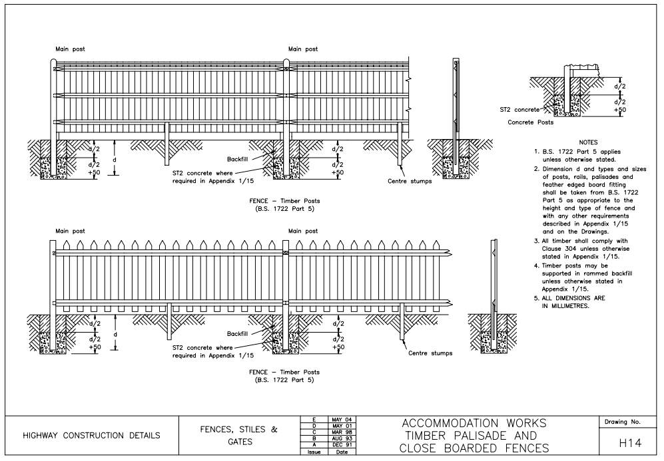
Defects on National Highways contracts
Example of a Defect which was accepted by National Highways
The Scope states that landowner’s boundary fence should be close boarded wooden fence, no less than 2m high and be painted colour RAL 6001 (green).
The Contractor constructed the correct type of fence but painted the it using an incorrect shade of green.
Upon consultation, the landowner is happy to accept the defective colour fence and since the Defect does not impair the performance of the works, the Project Manager can amend the Scope to accept the Defect.

Slide 43
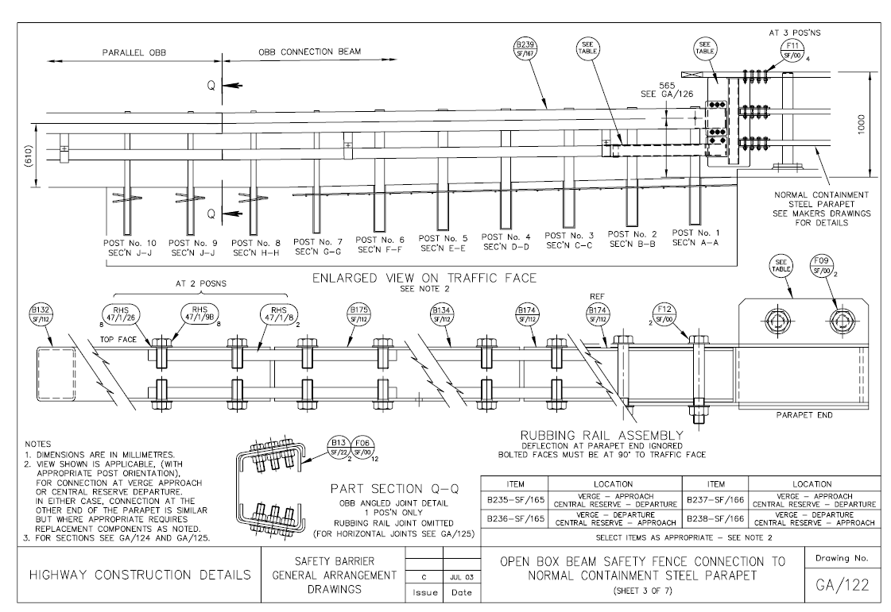
Defects on National Highways contracts
Example of a Defect which was not accepted by National Highways
The Scope states that the Vehicle Restraint System (VRS) barrier extends from the roundabout for 200m on each side of the southern leg of the roundabout. The Scope also states that no street furniture, including street lighting, is to be placed between the traffic lanes and the VRS.
The Contractor mistakenly installed the lighting columns in the wrong location which ended up being in front of the VRS.
The Defect was notified to the Contractor who was then obliged to correct the Defect.

Slide 44
Tests and inspections for long form of contracts
Requirements for tests and inspections are included in the Engineering and Construction Contract (ECC), Term Service Contract (TSC) and Supply Contract (SC), but not the Professional Service Contract (PSC).
Testing and inspections are used to identify Defects.
If a test or inspection shows any work has a Defect, the Contractor/Supplier corrects the Defect and the test or inspection is repeated.
Testing requirements in the NEC include requirements of the Client/Purchaser, Project/Service/Supply Manager, Supervisor and the Contractor/Supplier. These include (but are not limited to):
Parties must inform each other before commencing tests and inspections, and inform each other of the results, and
Tests and inspections undertaken by the Project/Service/Supply Manager/Supervisor should not cause unnecessary delay to works/service/goods and services or to a payment.

Slide 45
Fill in the blanks to complete the definitions
Question…
Question
Quality
Defect
Quality assurance
The -------- of a product or service to the customer’s --------.
Part of the goods, service or works that is not in accordance with ---------.
The process of ensuring attainment of standards and preventing the occurrence of --------.
the Scope
requirements
Defects
fitness

Slide 46
What are the definitions for the following terms?
Answer
Quality
Defect
Quality assurance
The fitness of a product or service to the customer’s requirements.
Part of the goods, service or works that is not in accordance with the Scope.
The process of ensuring attainment of standards and preventing the occurrence of Defects.

Slide 47
Tests and inspections
The model contract Scope includes details for testing including the objectives, procedures, standards and management of project specific testing.
The Client/Purchaser’s requirements for performance tests are also specified in the Scope e.g. who will undertake the testing and what Equipment is to be used.
Defects (Nonconformities) result in Quality Management Points described in detail later in this Awareness Guide.

Slide 48
Tests and inspections for short form of contracts
Requirements for tests and inspections are included in the ECSC, TSSC and SSC, not the PSSC.
Testing and inspections are used to identify Defects.
If a test or inspection shows any work has a Defect, the Contractor/Supplier corrects the Defect and the test or inspection is repeated.
The NEC states that the Client/Purchaser and Contractor/Supplier carry-out test and inspections required by the Scope.
The model contract Scope includes testing and inspection checklists for the compiler to review and populate with project specific information. This includes details of testing and inspection of Plant and Materials, offsite fabrication and installation activities.

Slide 49
Importance of quality to National Highways

Slide 50
Importance of quality to National Highways
Correct management of quality is important to achieving the National Highways imperatives and goals.
Customer Service
The basis of achieving quality is providing a product or service that meets the customer’s requirements. Operating a quality management system puts the needs of the customer at the centre of delivery.
The time for works to be completed is minimised if nonconformities are avoided. Good quality management makes delivery to customers more efficient and means the network can operate to its maximum potential.
Delivery
National Highways aim for no one to be harmed when travelling or working on its network by 2040. Quality management systems improve risk management through monitoring processes and carrying out appropriate tests to identify nonconformities at an early stage.
Safety
Effective quality management reduces the rework that is required. This reduces the resources consumed, waste produced and negative impact on the environment.
+ Environment

Slide 51
Example of issues that arise when works procured do not meet quality requirements
Example of works not meeting quality standard
Arising issue
Consequences
Poor construction quality, for example uneven carriageway surfacing caused by poor workmanship or a Defect in the materials, delivered by a highway improvement scheme.
Not meeting the quality standard would result in a safety concern. The reputation of National Highways may be impacted if they caused accidents for road users and deemed unsafe.
Additional cost and time to rectify Defect. Additional disruption to public due to increased duration of works.
Additional costs for project management for National Highways staff associated with increased construction programme duration.

Slide 52
Quality management requirements for long form of contracts

Slide 53
Contract specific quality requirements
Quality requirements within National Highways are a combination of the following three elements:
NEC
Denotes the quality requirements associated with the published NEC4 contracts.
Model
Denotes quality requirements associated with National Highways model contract documents.
Project
Denotes project specific quality requirements.
The Scope of the National Highways model contracts compared in this section of the Awareness Guide are:
Engineering and Construction Contract (ECC),
Professional Service Contract (PSC), and
Term Service Contract (TSC).
Quality requirements for the short form of contracts are described later in this Awareness Guide.

Slide 54
Quality management
Quality management requirements are detailed in Section 4 of ECC, PSC, TSC and SC, and Contract Data Part 1 and Part 2.
National Highways specific quality requirements are included in the Scope.
Quality management requirements in the Scope are contained in S 600 of ECC, S 535-543 of PSC and S 600 of TSC.
Continual improvement requirements in the Scope are contained in S 630 of ECC, S 543 of PSC and S 630 of TSC.
Quality management is ensured through a quality management system.
Continual improvement is the base principle of quality management systems.

Slide 55
Quality management systems
A quality management system outlines how the Contractor/Consultant will achieve the standard required by the Client through a collection of policies, processes, procedures and records.
Section S 600 of the Scope (ECC), Sections S 535 and S 540 (PSC) and Section S 600 (TSC) details the requirements for developing, implementing and maintaining a quality management system and a quality plan.
NEC
A quality management system must be operated by the Contractor/Consultant.
Model
The quality management system must comply with ISO 9001, ISO 9004 and CEN/TS 16880.
Certification for the quality management system (ISO 9001) and environmental management system (ISO 14001) must be obtained from a United Kingdom Accreditation Service (UKAS) accredited body.

Slide 56
Quality management systems
The model contract documents include minimum certification requirements for the Contractor/Consultant’s quality management systems.
Additional project specific requirements can be added such as:
lean requirements,
dates when accreditation of quality management systems are required (may be on award or within a prescribed number of weeks of contract award), and
continuous improvement requirements.

Slide 57
Benefits to national Highways of a Contractor/Consultant using a quality management system
Gives confidence that appropriate checks have been completed prior to issue.
Has long term benefits with respect to saving time and money because it reduces common issues such as:
Checks of Contractors or Consultants work,
having to re-do work that does not meet quality requirements, and
having to pay for work to be redone.
Promotes a culture where quality is valued, and participation of employees is improved.
Puts the needs of the customer and business objectives at the centre of delivery.
Improves risk management.
Reduces waste and unnecessary negative environmental impact.
Provides better and more consistent control of business processes.
Improves performance of the Contractor/Consultant/Supplier.
These factors benefit National Highways because:
works/service can be delivered more efficiently and safely,
customer satisfaction is increased,
there is more time and money available to invest in development of the network, and
provides an opportunity to challenge incorrect contract delivery practices.

Slide 58
Quality plan
NEC
A quality plan must be produced by the Contractor/Consultant.
The quality plan details how the Client’s objectives for the contract will be met by the Contractor/Consultant, and must be accepted by the Project/Service Manager.
Model
A controlled copy of the quality plan is kept by the Contractor/Consultant and must be available for inspection at all times.
The standards to which the quality plan must comply are stated in clause Z1 within the model Contract Data.
Additional requirements may be included in the Scope.

Slide 59
Audits and Nonconformities
NEC
Section 4 Quality Management in NEC4 outlines the procedures for notifying and correcting Defects, and accepting or compensating for uncorrected Defects.
If at Completion (PSC), at the end of the defect correction period (ECC) or the end of the time specified by the contract (TSC), there are uncorrected Defects, the Contractor/Consultant pays the Client the incurred cost of the Defects being corrected by someone else.
The ECC has an exceptional case for if the Contractor was not allowed access to correct the Defects.
The Contractor then pays the Client what it would have cost for them to complete the work themselves.
Model
In model contracts documents, the term Nonconformities is used.
A Nonconformity is defined in BS EN ISO 9000:2015 and includes Defects.
The Contractor/Consultant is responsible for carrying out a programme of internal audits to the requirements of ISO 9001 (S 620 ECC, S 541 PSC, and S 620 TSC).

Slide 60
Continual Improvement
Model
Continual Improvement (and Innovation) form part of the Quality Management requirements in the model contract document Scope, S 630 of ECC, S 543 of PSC and S 630 of TSC.
It consists of five parts:
outcome requirements to be delivered by the Contractor/Consultant,
strategic objectives to support the outcome requirements,
performance measurement which is undertaken by the Contractor,
training which is provided by the Client, and
the methods (for Lean Continual Improvement and Structured Innovation).
The Contractor measures performance by:
recording reduction in cost on the Benefits Realisation Capture Form,
recording the improvement activity on a Knowledge Transfer Pack, and
recording both on the Client’s Lean Tracker.

Slide 61
Quality requirements: bespoke contracts
In some instances, CD&A can include bespoke quality requirements in the contract, that are not in the model contract documents or NEC4 contracts.
Project
Examples from Regional Delivery Partnership – Delivery Integration Partner:
The Supplier/Consultant produces a framework quality plan for framework level activities, in addition to Package Contract Quality Management plans for each individual package. The Framework quality plan contains additional content such as how the Supplier protects the Client from conflicts of interest in delivery of the service.

Slide 62
Quality Management Points

Slide 63
Quality Management Points and consequences
Model
The Contractor/Consultant accrues Quality Management Points if they fail to comply with their quality management system.
Quality Management Points accrued by the Contractor/Consultant impact on the allocation of future work on the contract and/or may lead to termination of the contract.
If the threshold of Quality Management Points is exceeded, the Contractor/Consultant must:
take actions to reduce the quantity of Quality Management Points immediately, and
register and report the Quality Management Points they have accrued to the Client.
Failure to comply with these procedures is considered a substantial failure of the Contractor/Consultant and is grounds for termination of the contract (reason R11 in NEC4).

Slide 64
Quality Management Points and consequences
Model
Quality Management Points are the mechanism through which National Highways manage the quality performance of their Suppliers.
The requirements for quality management systems and Quality Management Points can be found in the Scope.
National Highways promote active contract management. This includes proactively raising issues for the resolution of nonconformities.
Quality Management Points are accrued for failing to be proactive or for significant quality issues.

Slide 65
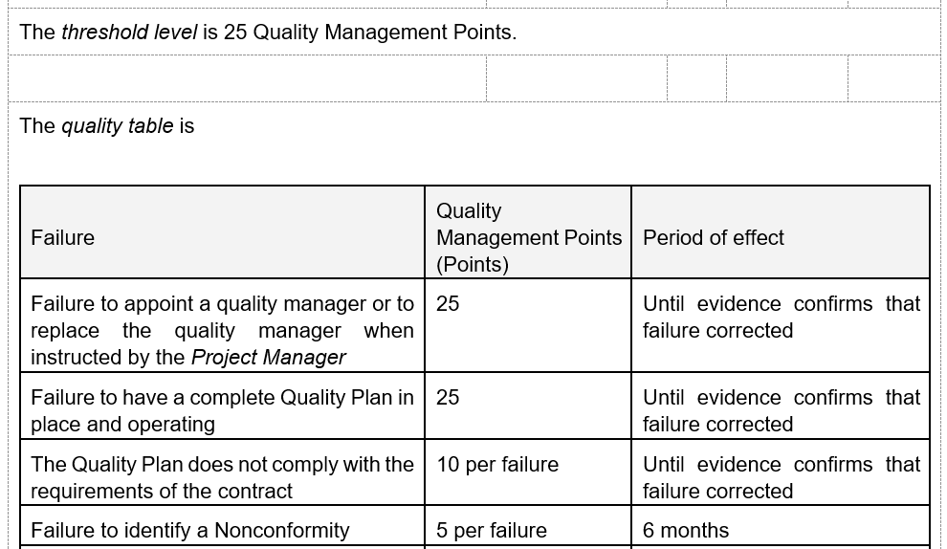
Quality Management Points – example
Model
The number of Quality Management Points allocated to the Contractor/Consultant for each failure is stated in the quality table in Contract Data along with the threshold level at which the Contractor/Consultant’s work allocation is affected.
Example from ECC model Contract Data Part One

Slide 66
Quality Management Points – example 2
Framework and bespoke contracts include mechanisms to ensure compliance with the quality requirements by the Contractor/Consultant by limiting or preventing work being allocated to them for significant or multiple failures.
National Highways Archaeology framework operates a threshold of 25 points and excludes Suppliers who exceed 25 Quality Management Points and who are not taking action to reduce the total number of Quality Management Points, from being selected for future Work Orders.

Slide 67
Contract Management Points
Contract Management Points can replace the use of Quality Management Points on some bespoke contracts at the discretion of CD&A (for example Scheme Delivery Framework).
Failure to comply with the quality requirements result in the Contractor/Consultant accruing Contract Management Points.
In addition the Contractor/Consultant can also accrue Contract Management Points for failure to adhere to environmental, health and safety and delivery requirements.
The number of Contract Management Points accrued by the Contractor/Consultant may affect the value of work allocated to them through the framework.

Slide 68
Contract Management Points - example
The Pavement Delivery Framework accrues Contract Management Points for failures associated with health & safety, delivery, quality and environmental failures. Examples of these are shown below (note this is not the full list).
Area | Failure | Contract Management Points | Period of Effect
Health & Safety | No Health and Safety Manager in post | 25 | Until Client is notified of the appointment of the Health and Safety Manager
Health & Safety | Failure to report incidents in line with GG128 | 5 per incident | Until incident reported, and investigation report issued
Delivery | Failure to maintain an accepted programme as required by the framework contract | 5 per Scheme | Until the Scheme Completion Certificate is issued
Delivery | Failure to submit a quotation as required by the framework contract | 5 per Scheme | Until the quotation is submitted to the Client
Quality | Failure to have a complete quality management system and quality plan in place and operating | 25 | Until the Supplier submits the quality management system and quality plan and these are accepted by the Client
Quality | Failure to identify a Nonconformity | 5 per Nonconformity | 6 months
Environmental | No Environmental Manager in post | 25 | Until the Client is notified of the appointment of the Environmental Manager
Environmental | Failure to implement an accredited carbon management system by 2025 | 15 | Until Supplier has implemented an accredited carbon management system

Slide 69
Quality management requirements for short form of contracts

Slide 70
Quality Management Systems
Model
NEC4 short form of contracts do not require the Contractor/Consultant/Suppler to operate a quality management system however this requirement is included in the model contract Scope (S 437 ECSC, S 535 PSSC, S 345 TSSC and S 316 SSC).
The quality management system must comply with ISO 9001, ISO 9004 and CEN/TS 16880.
Certification for the quality management system (ISO 9001) and environmental management system (ISO 14001) must be obtained from a UKAS accredited body.

Slide 71
Quality plan
Model
NEC4 short form of contracts do not require the Contractor/Consultant/Supplier to produce a quality plan however this requirement is included in the model contract Scope (S 437 ECSC, S 536 PSSC, S 345 TSSC and S 317 SSC).
Tender Commitments are promises (in writing) made by the Contractor/Consultant/Supplier included in their tender submission. They can involve a number of topics which may include commitments related to Quality (e.g. replying to correspondence within a fixed timeframe or programmed delivery of documents).
The quality plan must be sufficiently detailed to demonstrate how the Contractor/Consultant/Supplier achieves each of the Tender Commitments and meets the Client’s objectives for the contract.
A controlled copy of the quality plan is kept by the Contractor/Consultant/Supplier and must be available for inspection at all times.

Slide 72
Audits and Nonconformities
NEC
NEC4 outlines the procedures for notifying and correcting Defects, and accepting or compensating for uncorrected Defects.
If the Contractor/Consultant/Supplier has not corrected a notified Defect within its defect correction period (ECSC), by Completion (PSSC), within the time required by the contract (TSSC), or by the Delivery Date (SSC), the Client/Purchaser assesses the cost of having the Defect corrected by others and the Contractor/Consultant/Supplier pays this amount.
Model
In model contracts documents, the term Nonconformities is used.
A Nonconformity is defined in BE EN ISO 9001:2015 and includes Defects.
The Contractor/Consultant/Supplier is responsible for carrying out a programme of internal audits to the requirements of ISO 9001 (S 439 ECSC, S 541 PSSC, S 345 TSSC and S 319 SSC).
A Defect is an NEC term whilst a Nonconformity is defined in ISO 9001 includes a failures to meet required standards which can include regulatory requirements.

Slide 73
Awareness Guide learning outcomes recap
You should now:
Understand insurance and liability requirements and levels.
Understand quality management requirements in National Highways contracts.

Slide 74
For further questions please visit

Slide 75
Glossary of terms
“Black” text: text in the model contract documents which may not be amended without agreement of CD&A. For further details see Awareness Guide 3.
Close out: project management requirements at the end of a project or contract.
Commercial Delivery (CD): team within National Highways.
Commercial Modelling (CM): team within National Highways
Commercial and Procurement Strategy (CPS): strategy for the development and procurement of a contract within National Highways.
Conditions of contract: the contract clauses including NEC4 and National Highways Z clauses.
Contract Data: forms part of the conditions of contract.
Contract Development and Assurance (CD&A)
Defect: part of the service or works not in accordance with the Scope.

Slide 76
Glossary of terms
defect: shortcoming or imperfection in an asset (e.g. pothole).
Defined terms (capitalised): definition of term provided in NEC contract, National Highways Clause Z1 or Annex 01 of the Scope.
Identified terms (italics): terms identified in Contract Data Parts One and Two e.g. Contractor, Site.
International Organisation for Standardisation (ISO): international series of standards covering quality, environmental management, information security management etc.
Invitation to Tender (ITT): instructions issued to the Contractor, Consultant or Supplier giving details of the procurement process and tender opportunity.
Key Performance Indicator (KPI): contractual incentives for monitoring and promoting good performance, or disincentives for poor performance.
Model contract document: contract documents incorporating National Highways standard requirements.

Slide 77
Glossary of terms
New Engineering Contract (4th edition) (NEC4): suite of contracts published by the ICE which includes:
ECC: Engineering and Construction Contract,
ECSC: Engineering and Construction Short Contract,
PSC: Professional Service Contract,
PSSC: Professional Service Short Contract,
TSC: Term Service Contract,
TSSC: Term Service Short Contract,
FC: Framework Contract,
SC: Supply Contract, and
other contracts within the NEC4 suite are rarely used by National Highways.

Slide 78
Glossary of terms
Package Order: used on some Framework Contracts to describe a group of work/task orders awarded to the same Supplier.
Procurement Division (PD): team within National Highways.
“Red” text: text in the model contract documents which may be altered by the Compiler. For further details see Awareness Guide 3.
Section 278 (S278): section of the Highways Act 1980 allowing developers to make alterations to the public highway.
Selection Questionnaire (SQ): questionnaire used during tender.
Strategic Road Network (SRN): highway network managed by National Highways.
Subject matter advisors (SMA): advisors from within National Highways with an expertise in defined areas e.g. pavements, carbon, sustainability etc.

Slide 79
Glossary of terms
Task Order: used in some Framework Contracts to define a piece of work awarded to the Contractor e.g. undertake a survey or design a new junction.
Tender commitments: written commitments made by tenderers which are incorporated into the contract and monitored and assessed during the contract period.
Tribunal: form of dispute resolution (e.g. arbitration or adjudication).
Work Order: used in some Framework Contracts to define a piece of work awarded to the Contractor. E.g. undertake a survey or design a new junction.
Z Clauses: clauses written by the Client which add to, remove, replace or amend existing NEC contract clauses.

